Slide 1
Growing push to promote student ‘voice’, student engagement, ‘students as partners’
Co-creation – ‘students & academic staff working in partnership to create some or all aspects of the planning, implementation & evaluation of the learning experience’ (Bovill et al 2011: 137)
Not ‘new’ to feminist academics - long-standing emphasis on disrupting power dynamics, reflexivity & valuing personal experience as site of academic enquiry

Slide 3
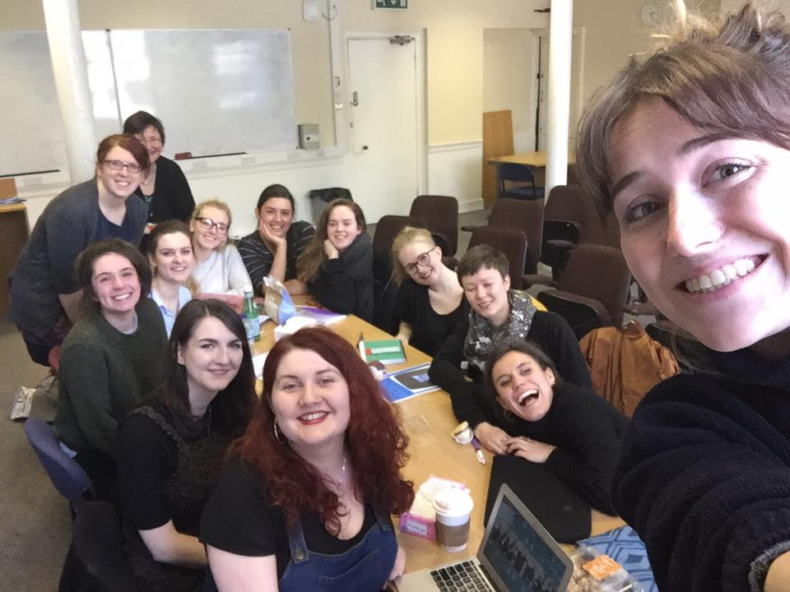
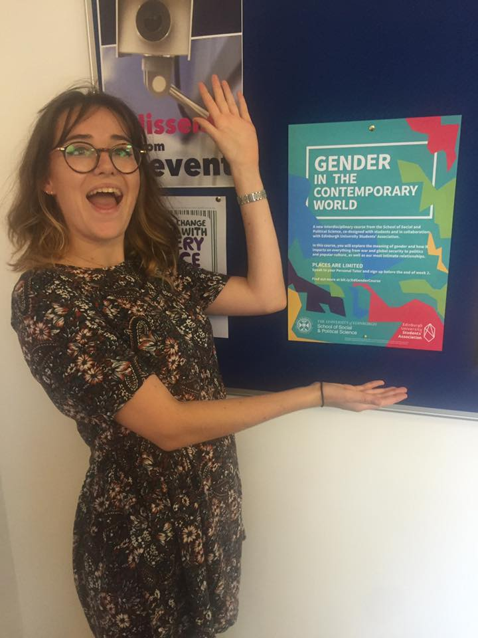
SPS in Practice

Slide 4
LEARNING CONTRACT
WAYS OF WORKING & CLASS CONDUCT
e.g. ‘make the course as accessible as we can & think about how to accommodate different learning styles and knowledge levels’
OBJECTIVES (What are you going to learn? Itemize what you want to be able to do or know by the end of the course)
RESOURCES AND STRATEGIES (How are you going to learn it? What do you have to do in order to meet each of the objectives?)
DATE FOR COMPLETION (When do you plan to complete each task?)
EVIDENCE (How are you going to know that you learned it? What is the specific task that you are to complete to demonstrate learning?)

Slide 5
COURSE STRUCTURE
WEEK 1 | Overview and Negotiation of Learning Contract
WEEK 2 | Key Skills
WEEK 3 | Using Diaries to Teach Gender
WEEK 4 | Independent Group Meetings & Preparation
WEEK 5 | Group 1: Topic TBC Mid-Semester Evaluation of Learning Contract
WEEK 6 | Group 2: Topic TBC
WEEK 7 | Group 3: Topic TBC
WEEK 8 | Independent Group Meetings & Preparation
WEEK 9 | Group Poster Presentations (in class)
WEEK 10 | Independent Group Meetings & Preparation
WEEK 11 | Guidance on Assessment, Student Evaluations & Collective Debrief

Slide 6
What Did They Produce?
Learning Portfolio (60%), incl:
Annotated reading list
Relevant online resources
At least one interactive tutorial exercise
Project Reflective Journal (25%)
Reflecting on personal development over the course (what you did, why you did it, what worked and what didn’t) & engaging with relevant pedagogic literature
Group Presentations (15%)
Mid-semester group PPT presentation to University Gender Reference Group (5%) and in-class poster presentation at end of course (10%)

Slide 7
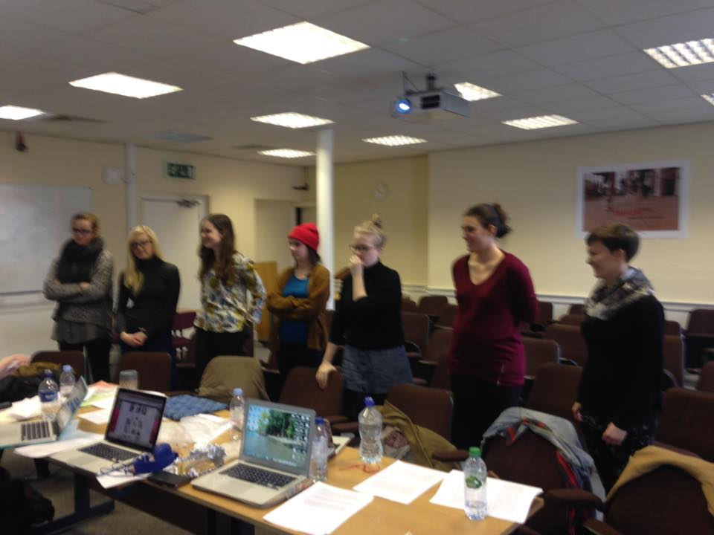
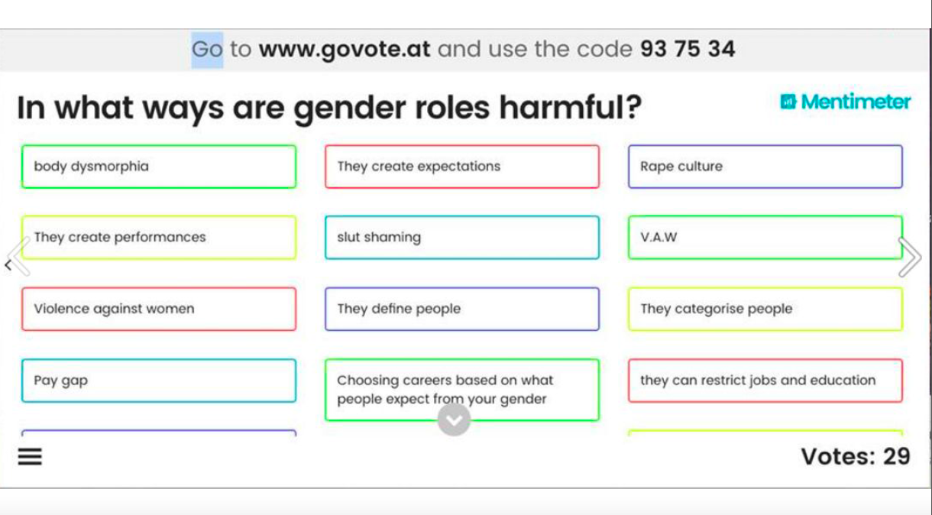
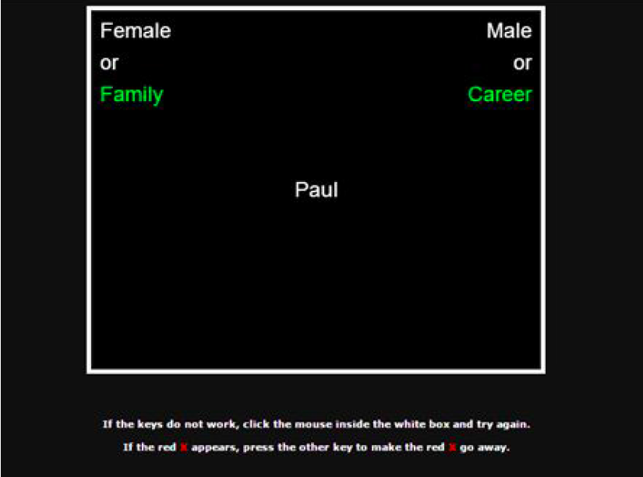

Slide 8
Gender Observations (2016/17)
‘In the Library Bar, gender was performed in ways that allowed the men to occupy the most space. But the environment itself was shaped by raced and classed power structures, which in turn shaped gender performances. The university bar is available to the likes of those attending the university itself (mostly white, upper/middle class)…’
‘Despite the fact that my schooling experience has been in all girls environments, I realised that even in primary school there were often groups of girls that took on the 'normal' role of boys, by playing football in the centre of the playground for example instead of braiding hair around the outside, supporting the argument that girls take up marginalised positions even from a young age (Ringrose 2012).‘
Correlating with studies of Thorne (1993) and Davies (2006), a salient example of my peers and my own means of ‘doing gender’ was ‘kiss-chasing’, a chasing game in which usually boys attempt to kiss girls. In my opinion, this acutely illustrates our active creation of gender as we participated in ‘borderwork’ (Thorne, 1993) through gender separation of children playing, mimicking the relational nature of ‘doing gender’ arguably learnt from witnessing adult interactions.’

Slide 9
Lessons & Reflections: Benefits
Potential (re)invigoration & renewal of enthusiasm & engagement w/ learning process
Different perspective on (& deeper understanding of) own learning & pedagogical rationales (‘visible’ teaching & learning)
A ‘project with a purpose’ (vs traditional assessment) – confidence, empowerment, ownership, self-authorship
Positive impact on student performance

Slide 10
Lessons & Reflections: Challenges
Project ‘nested’ within wider course design power dynamics – students not always ‘equal’ partners
Reifying student ‘voice’? Potential for co-optation? Whose voices do we hear? Where are the silences & margins?
Assuming expertise – requires support & training
Time & resource-intensive – (gendered) costs, particularly within current HE climate

Slide 11
