Slide 1
Catalytic tools for encouraging metacognitive engagement with pedagogy
Professor Kate Wall, University of Strathclyde
19th January 2018
Kate.Wall@strath.ac.uk
@kate_wall98
Notes:
Thank you
This presentation comes from a culmination of different thinking about teaching and learning – across a number of different projects – L2L, Equate etc.
Unapologetic in the use of the term teacher throughout (and I hope I don’t turn you all off at this point) as it is teaching in its many guises that I am talking about although it might be happening in the HEI sector.

Slide 2
Feedback loops become mutually reinforcing
SUBJECT
Teacher
PEERS
SELF
Kate.Wall@strath.ac.uk
@kate_wall98
Notes:
An activity/ an input by the teacher will have certain
However beware pedagogic half life

Slide 3
Individuals as active participants
To maximise the potential of these feedback loops then:
Students must be active in the process
Awareness, knowledge and skills
Power, decision making over their learning
Clear communication of expectations and learning intentions
Metacognitive explanation
Essential that we close the loop
Student contribution
Student voice
Effective learner dispositions
Trust
Teacher
Kate.Wall@strath.ac.uk
@kate_wall98
Notes:
Example of Fallibroome

Slide 4
Giving students a voice (about their learning)
Creating democratic spaces
Time to think
Time to talk: ‘to have a say’
Time to listen to others’ opinions
Teachers listening and acting
Giving ownership of learning
Trust to do the right thing
Time to act on what they think/hear
Share learning trajectories
TOOLS…
Kate.Wall@strath.ac.uk
@kate_wall98

Slide 5
CATALYTIC Tools
A catalytic tool helps support effective feedback tools by supporting the effective flow of information between teacher and student.
A catalytic tool will:
Provide a space for productive talk
Can be used in many different ways and for different purposes
Fulfill more than one of these objectives at any one time
Provide feedback to teacher and student simultaneously (all though not necessarily in the same way)
Teacher
Scaffold
Learning moment to moment
Measure
Feedback on process/ progress
Lens
Generate new perspectives
Frame
Change ways of interacting
Kate.Wall@strath.ac.uk
@kate_wall98

Slide 6
A Typology of Tools
Tool type | Intent
Scaffold | Supporting learning moment to moment
Measure | Providing feedback on process, progress, understanding or affect
Lens | Generating new perspectives, focusing in on detail or outwards to gain perspective
Frame | Changing structures for talk or for interaction
“When using a new tool in the context of pedagogical practice, the teacher has the opportunity to engage in a re-framed experience. The experience will have aspects of familiarity – since the tool is grounded in the territory of learning – and of novelty – since something is being added to the repertoire. This combination of security and novelty creates the conditions for the teacher to experience ‘positive dissonance’ “
(Baumfield, Hall, Higgins and Wall, 2009)
Kate.Wall@strath.ac.uk
@kate_wall98

Slide 7
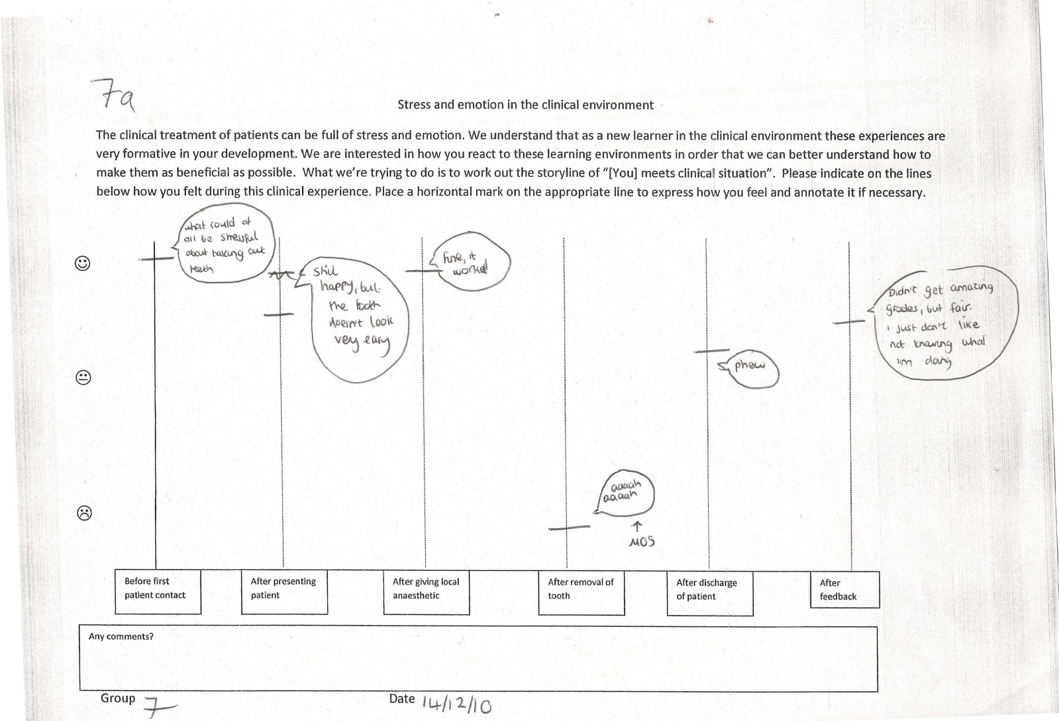
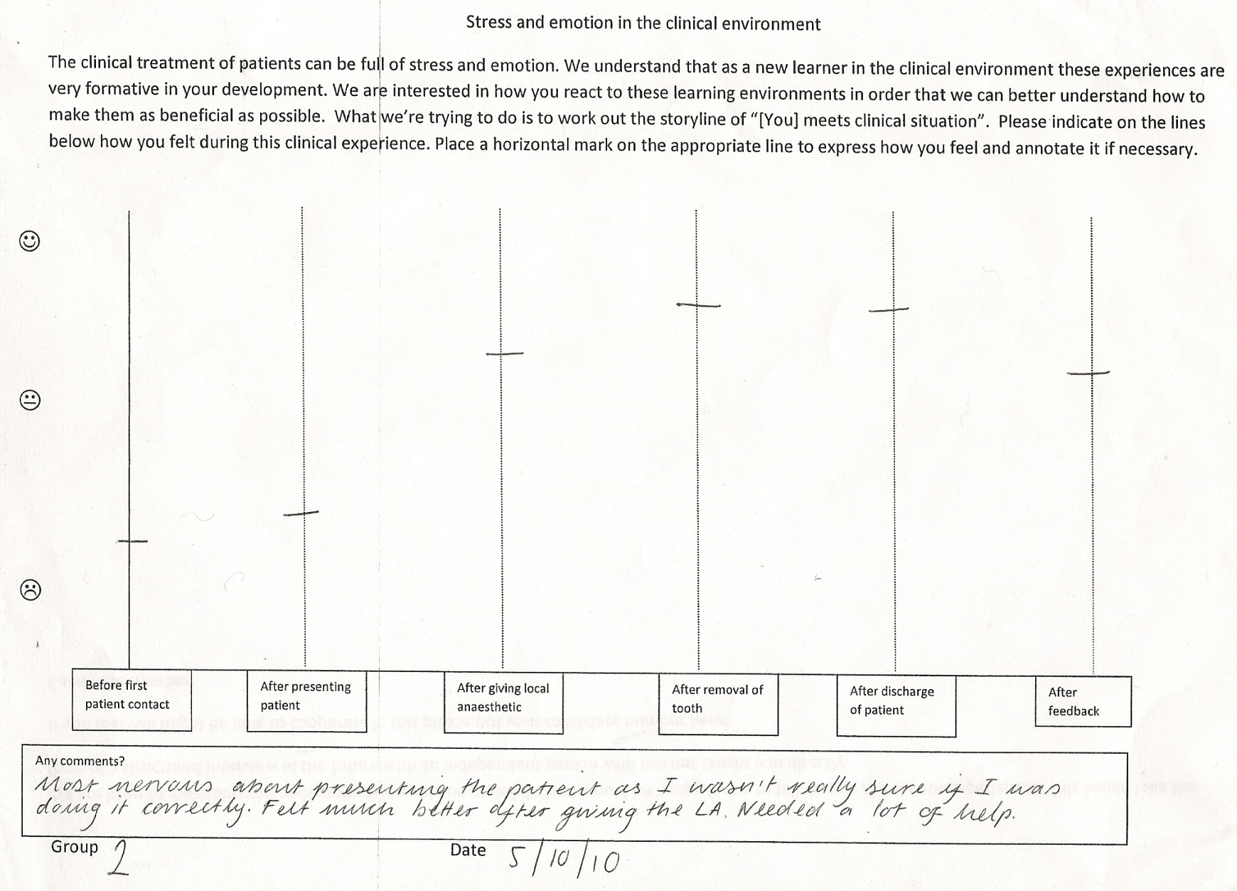
Tools that support talk about learning: example
Undrell Moore, School of Dentistry, Newcastle University
Fortune Lines
Is there an emotional content in the oral surgery clinical learning environment?
How does it affect student attitudes to learning and clinical work?
3rd year dental students (age ≈ 21yrs)
First clinical encounters with patients
First local anaesthetic administrations
Doing irreversible damage (tooth extraction) for the first time
Kate.Wall@strath.ac.uk
@kate_wall98

Slide 8
Powerful tools: Fortune Lines
Feedback for Teacher
Feedback for Student
Scaffold
Learning moment to moment
Measure
Feedback on process/ progress
Lens
Generate new perspectives
Frame
Change ways of interacting
Kate.Wall@strath.ac.uk
@kate_wall98

Slide 9
Pedagogic half life
If you use a tool too much/ too often then you errode its power
Think reflectively and strategically about when and how
As a result need to build up a pedagogic repertoire
Kate.Wall@strath.ac.uk
@kate_wall98

Slide 10
Concluding thoughts
Learning is personal and abstract, but inherent in all individuals’ (including teachers’) trajectories
Opening up a dialogue about learning (metacognition) means learners tend to take an enquiry stance: they have questions about their own and others’ approaches to learning. It is a very open topic.
A link with student voice is catalytic to metacognitive awareness (the skills, dispositions and the classroom environment) underpins a classroom where learning is up for discussion
Teachers that open up dialogue about learning with their students changes the way they think about themselves as teachers and learners
By articulating our own learning successes and failures teachers are demonstrating that learning is hard work, complex and lifelong/lifewide
Kate.Wall@strath.ac.uk
@kate_wall98

Slide 11
Contact information
Kate Wall
School of Education, University of Strathclyde, Glasgow, Scotland
Kate.Wall@strath.ac.uk
@kate_wall98
Slides taken from a larger presentation available on my researchgate and academia.edu sites

