Slide 1
The Edinburgh Award:
Engaging students at scale, at distance, and during vacation…
Lizzie Mortimer
Careers Consultant
Elizabeth.mortimer@ed.ac.uk

Slide 2
The context: Edinburgh Award (Summer Work Experience)
This version of the Award recognises student involvement in summer work experience.
Alongside setting development goals and submitting written reflections on their experience, participants must attend inputs at the start, middle and end of the Award.
Challenge with scaling the Award, programme required a face-to-face session in Edinburgh in both May and September.
In 2017 we put the Award full online, using a variety of platforms to support it, and a blend of synchronous and asynchronous inputs

Slide 3
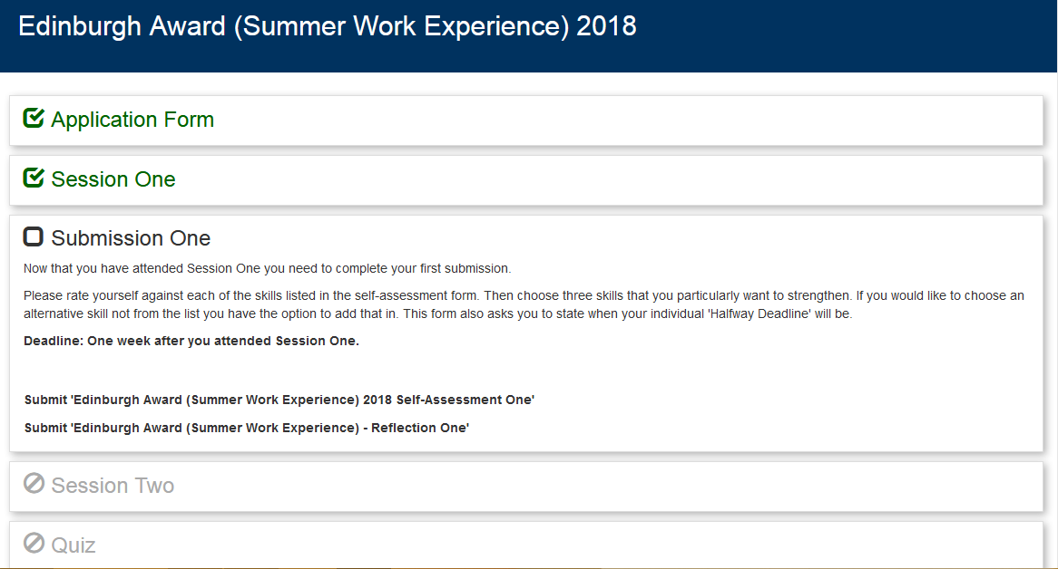
Using MyCareerHub to manage workflow

Slide 4
Engaging students using Collaborate
Polls
Message board
Interactive white board
Break out rooms for group exercises

Slide 5
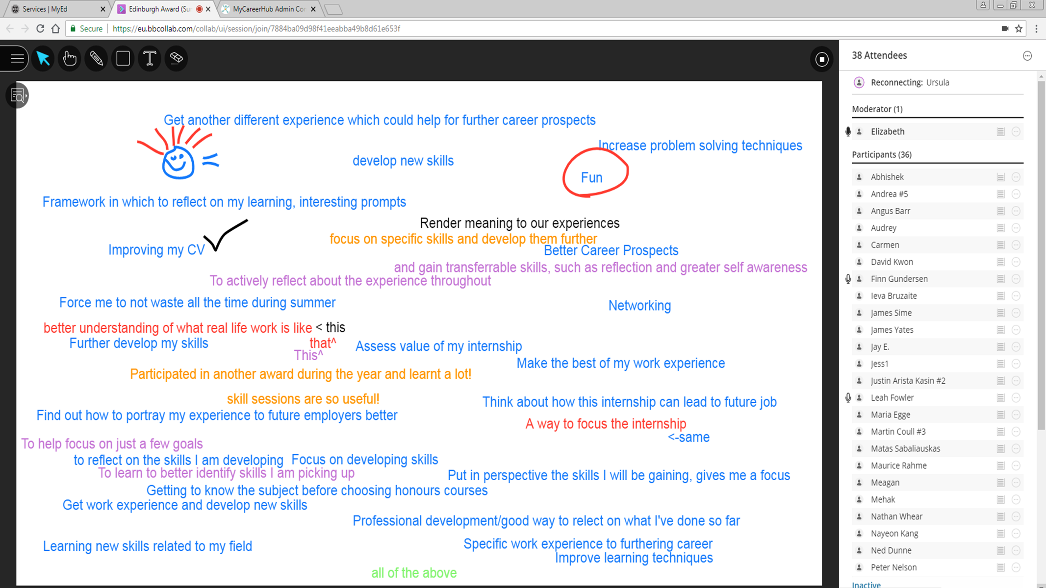

Slide 6
Results
“I think the Award was really well-organised and I liked the use of Padlet as it was interesting to see what everyone else was doing over their summer and the projects they were involved in.”
“It was convenient… I would have been unable to attend sessions in person here in Edinburgh”
“It has been excellent. If we had to participate in non-online sessions, it could be a bit complicated to do it.”
100% would recommend to a friend
160% increase in participants since moving fully online
20% improvement in retention
Significant staff time saved

Slide 7
Future plans
Offer a year-round Edinburgh Award (Work Experience) programme with flexible roll on and roll off points
Continue to scale participation, automating the process as much as possible to ease admin burden
Incorporating peer review of submissions through Learn PeerMark

