Slide 1
Complicating inclusivity and diversity in student engagement and partnership: whose voice gets heard?
Dr Lucy Mercer-Mapstone, Endeavour Research Scholar,
Institute for Academic Development, University of Edinburgh

Slide 2
(+)diversifying cohorts
(-)updated practices
Current
practice:
(+) traditional
(-) underrepresented
Evidence that high-impact practices have
compensatory effects
@lucymercermaps #studentsaspartners

Slide 3
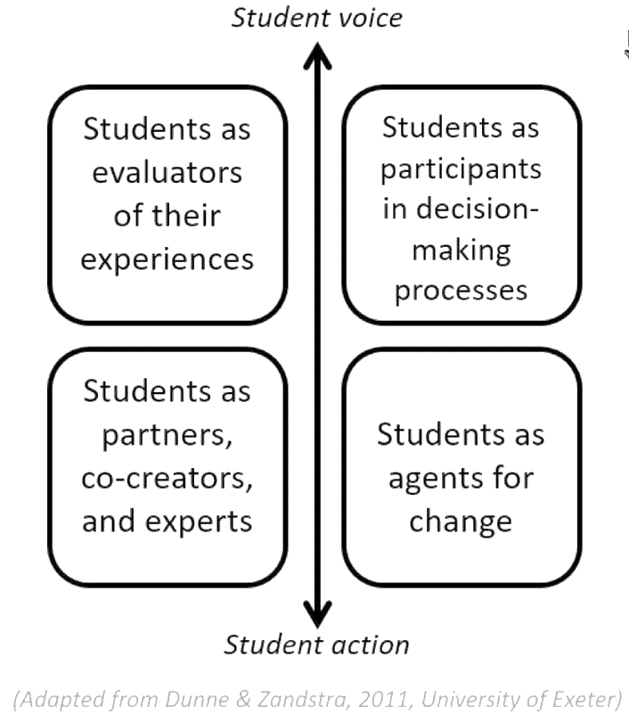
Adapted from Dunne & Zandrsta (2011)
@lucymercermaps #studentsaspartners

Slide 4
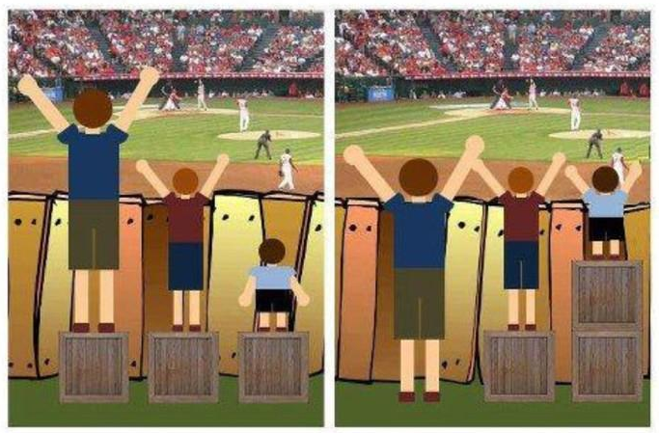
@lucymercermaps #studentsaspartners

Slide 5
What individual students need
equity
Versus
Equality?
All students the same
@lucymercermaps #studentsaspartners
Notes:
Equity is giving everyone what they need to be successful. Equality is treating everyone the same. Equality aims to promote fairness, but it can only work if everyone starts from the same place and needs the same help.

Slide 6
Unpacking ‘inclusive engagement’
@lucymercermaps #studentsaspartners

Slide 7
Aspiring to be a (more) inclusive practitioner
@lucymercermaps #studentsaspartners

Slide 8
Powerful prose
@lucymercermaps #studentsaspartners

