Slide 1

What do Edinburgh Students Want?
Analysing NSS results and implications for student engagement
Jill MacKay (jill.mackay@ed.ac.uk)
Neil Lent (n.lent@ed.ac.uk)
Kirsty Hughes (kirsty.hughes@ed.ac.uk)
Hazel Marzetti (hazel.marzetti@ed.ac.uk)
Susan Rhind (susan.rhind@ed.ac.uk)
@jilly_mackay

Slide 2
The Importance of Qualitative Data
QAA New Enhancement Theme running until 2020
Evidence for Enhancement: Improving the Student Experience
What data helps us:
  Identify what we do well
  Prioritise interventions
  Evaluate effectiveness

Slide 3
Methods
In the beginning . . .
3 schools’ data explored by JM, HM, KH and NL
All 4 researchers independently coded same 20 responses to identify themes and establish consistency
Schools then divided between KH, HM and JM
Each school coded by a single researcher
New themes could be generated

Slide 4
Overview of Themes
Table 1: Seven broad themes extracted from the NSS 2016 responses and some of their sub-themes
Theme | Sub-Themes
Organisation | Good and bad organisation
Community and Alienation | Student feedback not valued
Facilities
Student Concerns and Self-Development | Confidence, enjoyment of materials, help with living in Edinburgh
Learning and Teaching | Language skills (staff), consistency of teaching
Assessment and Feedback | Exam timetabling, assessments not fitting course, assessments too challenging, grade bands confusing, marking inconsistent, feedback late, no feed-forward
Staff Have Research Focus | The staff were considered experts in their field, or may prefer research to teaching.

Slide 5
Overview of Themes
Table 1: Seven broad themes extracted from the NSS 2016 responses and some of their sub-themes
Theme | Sub-Themes
Organisation | Good and bad organisation
Community and Alienation | Student feedback not valued
Facilities
Student Concerns and Self-Development | Confidence, enjoyment of materials, help with living in Edinburgh
Learning and Teaching | Language skills (staff), consistency of teaching
Assessment and Feedback | Exam timetabling, assessments not fitting course, assessments too challenging, grade bands confusing, marking inconsistent, feedback late, no feed-forward
Staff Have Research Focus | The staff were considered experts in their field, or may prefer research to teaching.

Slide 6
Theme: Community & Alienation
Students wanted to feel as though they were a valued member of their academic community.
For four years I have been treated like a second-class citizen compared to the postgraduate research students. – CSE
Undergraduates are not important. Research students and research projects are the priority. – CAHSS
How does feeling excluded encourage engagement?

Slide 7
Theme: Student Concerns & Self-Development
[What one thing…] Not being made technically homeless.
- CAHSS
[My] supervisor was very supportive and understood my needs as a mentally ill student. He/She also gives very fair and useful feedback and is very approachable and friendly. He/She explains difficult concepts very well.
- CAHSS
Money to buy food. Money to buy a new laptop. Money to buy clothes. Money to buy books. – CAHSS
This reminds us that students aren’t engaging with their programmes in isolation.

Slide 8
Theme: Learning & Teaching
The staff are often really good, however some just don't care about teaching. Great teachers should be rewarded more.
- CSE
Staff are academic and more concerned with their own personal interests. This often makes their lectures irrelevant. It seems they would rather not be teaching and that can be confidence-knocking for us.
- CMVM
Edinburgh lives off the fact that it's Edinburgh. So don't invest in their lecturers, I've been taught by my retired teachers who have no enthusiasm for their course anymore and the department has failed to tackle the issue.
- CSE
Why should students engage if we don’t?

Slide 9
Theme: Staff Have Research Focus
Maybe the biggest positive aspect is the reputation of the university as a whole and in the field. There are a lot of extremely smart lecturers, highly competent in their field.
- CAHSS
Lecturers seem to be more interested in their research than their teaching skills – some have no desire to make the course interesting. This has got a lot better by the later years in the degree but certainly; in 1st and 2nd year, the teaching quality was poor.
- CSE
Research focus can promote positive engagement

Slide 10
Theme: Assessment & Feedback
While some course give detailed feedback on where to improve in assignments and reports, most courses have not done that. This makes it significantly harder to strive to improve. Maybe a sample type of report done by an upper year should be provided as a reference to show students what exactly markers are looking for. Also the criteria for marking are extremely vague (have mentioned this a few times in the past, please elaborate so students know what is required of them).
- CSE
Moreover in certain situations, markers graded in vastly different ways, so the difference between the grades of any two students was more dependent on who the marker is, rather than anything else
- CAHSS
Vagueness and inconsistency inhibit self-regulation

Slide 11
Lessons for Student Engagement
Students who feel excluded aren’t encouraged to engage.
Students aren’t engaging with their programmes in isolation.
Why should students engage if we don’t?
Research focus can promote positive engagement
Vagueness and inconsistency inhibit self-regulation

Slide 12
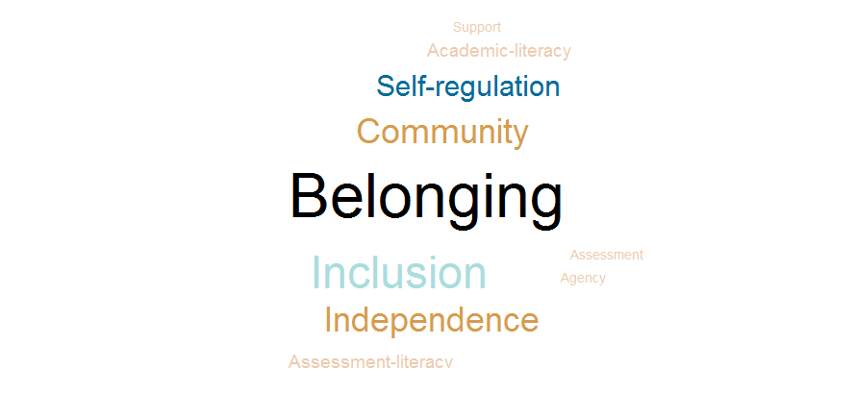
Lessons for Student Engagement

