Slide 1
Analysing NSS results and implications for student engagement
Dr Alex Buckley
University of Edinburgh, 4th December 2018

Slide 2
“[A]t the university level, there are relatively few universities that differ significantly from the mean across all universities and, at the course level, there is even a smaller portion of differences that are statistically significant. This suggests the inappropriateness of these ratings for the construction of league tables.” (Cheng and Marsh 2010)

Slide 3
Statistical significance and confidence intervals

Slide 4
1. How different are the scores from other institutions?
2. How different are they from last year?
3. How different are they from the sector average?

Slide 5
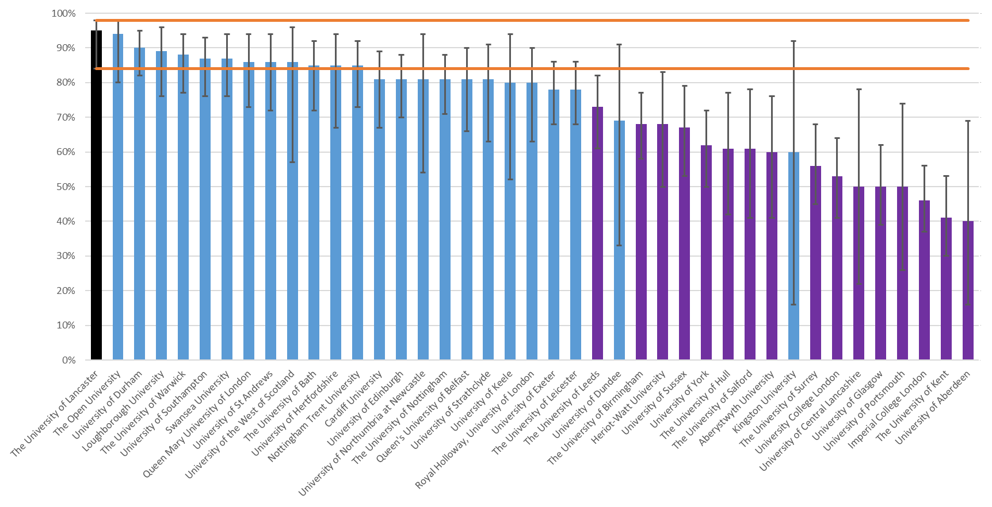

Slide 6
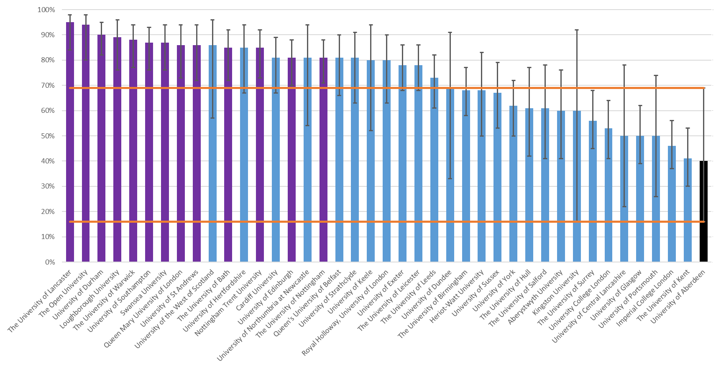

Slide 7
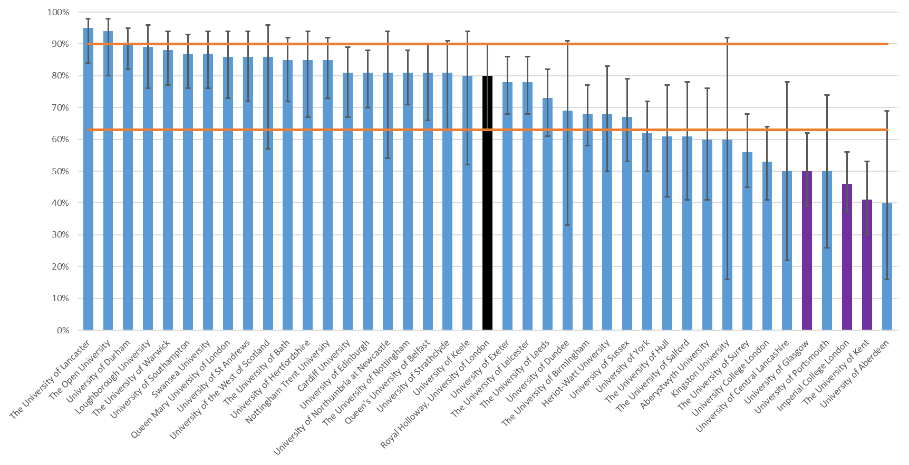

Slide 10
27
17
6
½
- Total questions
- Questions that differ from at least one other uni
- Questions that differ from sector average
- Questions that differ from previous year
- (6%)
- 24%
- 2%

Slide 11
“[T]here is an assumption that when teachers transmit feedback information to students these messages are easily decoded and translated into action. Yet, there is strong evidence that feedback messages are invariably complex and difficult to decipher, and that students require opportunities to construct actively an understanding of them (e.g. through discussion) before they can be used to regulate performance” (Nicol and Macfarlane-Dick 2006)

Slide 12
“[T]here is an assumption that when students transmit feedback information to teachers these messages are easily decoded and translated into action. Yet, there is strong evidence that feedback messages are invariably complex and difficult to decipher, and that teachers require opportunities to construct actively an understanding of them (e.g. through discussion) before they can be used to regulate performance” (Nicol and Macfarlane-Dick 2006)

Slide 13
Working with students to explore NSS data
Incorporating critique of NSS questionnaire and analysis of NSS data into statistics module
Helping SU to use NSS to develop yearly priorities and objectives
Funding a student researcher to work with the SU to explore the text comments
‘Commissioning’ NSS analysis from student reps, supported by staff
Staff & student conference to reflect on NSS scores and shape institutional policy and practice
(examples from Buckley 2012)

Slide 14
“A number of institutions have in effect handed over the administration of local questionnaires and interpretation of the NSS to students, and there is some evidence that NSS scores improve when students are engaged in this way.” (Gibbs 2012)

Slide 15
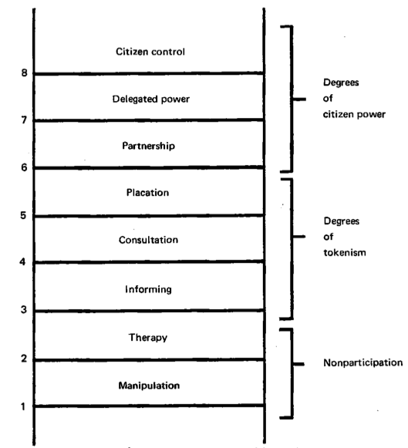
“There is a critical difference between going through the empty ritual of participation and having the real power needed to affect the outcome of the process.” (Arnstein 1969)

Slide 16
“... universities should treat learning as not yet wholly solved problems and hence always in research mode.”
(von Humboldt 1810, cited by Elton 2005)
“[T]he teaching-research nexus should be what distinguishes higher education from high school or vocational education. An important aim of higher education is to support students to realize not only the contested uncertain nature of knowledge, but also the importance and the fascination of pursuing that knowledge.”
(Healey and Jenkins 2006)

Slide 17
Questions for discussion
If you are involved in student voice activities, where on the ‘ladder of participation’ do they sit?
Is the interpretation of your NSS results treated as a “not yet wholly solved problem”?

Slide 18
References
Arnstein, S. (1969). A ladder of citizen participation. Journal of the American Planning Association 35(4): 216-224
Buckley, A. (2012) Making it Count: Reflecting on the National Student Survey in the process of enhancement. York: Higher Education Academy.
Cheng, J. and Marsh, H. (2010) ‘National Student Survey: Are differences between universities and courses reliable and meaningful?’ Oxford Review of Education 36(6): 693- 712
Elton, L. (2005) Scholarship and the research and teaching nexus. In: Barnett, R. (ed.) Reshaping the university: new relationships between research, scholarship and teaching. Maidenhead: McGraw-Hill/Open University Press, 108–18.
Gibbs, G. (2012). Implications of ‘Dimensions of Quality’ in a Market Environment. York: HEA.
Healey, M. and Jenkins, A. (2006), ‘Strengthening the Teaching-Research Linkage in Undergraduate Courses and Programs’, New Directions for Teaching and Learning 107: 45-55
Nicol, D. and Macfarlane-Dick, D. (2006) ‘Formative assessment and self‐regulated learning: a model and seven principles of good feedback practice’, Studies in Higher Education 31(2): 199-218

