Slide 1
Evaluating two feedback mechanisms for MCQ exams
David Hope, Kyle Gibson & Helen Cameron
August 2013

Slide 2
Background
Feedback is seen as an integral part of assessment
Most work on feedback focuses on clinical contexts
MCQ exams represent much of the assessment in undergraduate medical education (Scouller, 1998)
Feedback does not consistently improve performance in clinical contexts (Boehler et al. 2006)
Can we deliver satisfying and useful feedback for MCQ exams?

Slide 3
Summary of Work
196 students (completion rate over 95%) sat a 30 minute formative cardiovascular exam
OSCA-FM: 50% received detailed, immediate feedback explaining each option for each question but they could not take the feedback away
Tagging: 50% received a summary of their performance on a number of domains and they could keep this indefinitely
Students sat a further 30 minute formative exam three weeks later

Slide 4
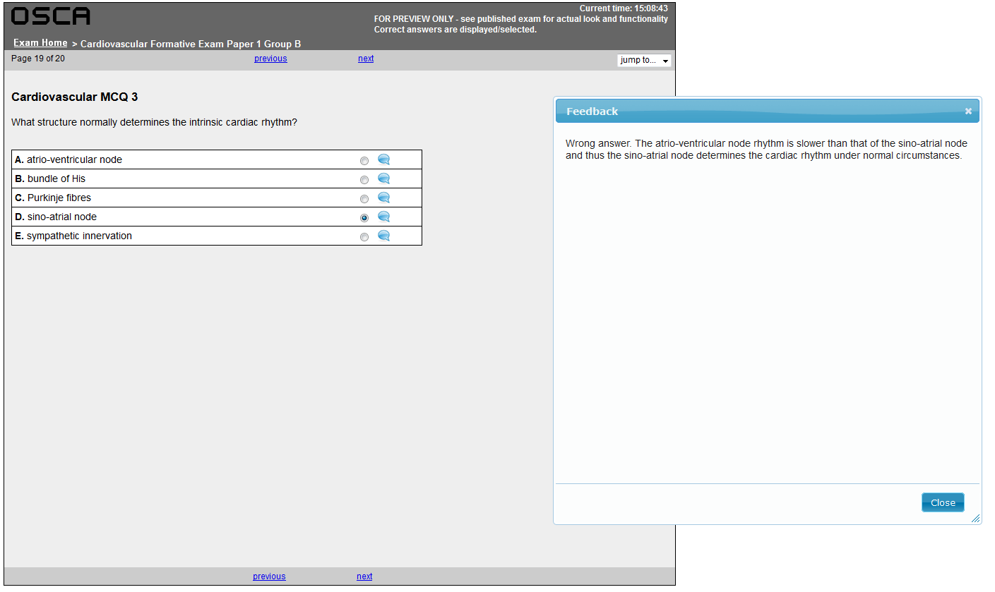
OSCA-FM

Slide 5
Tagging
Tag | Score | Average | Max
Cardiovascular | 42 | 38 | 50
Biomedical Sciences | 42 | 38 | 50
Presentation Diagnosis and Management | 23 | 25 | 31
Clinical pharmacology and therapeutics | 25 | 19 | 25
Anatomy | 9 | 9 | 9
Physiology | 28 | 22 | 28
Pathology | 8 | 11 | 16
Chest pain | 3 | 2 | 3
Congenital Heart Disease | 8 | 11 | 16
Lipids | 3 | 3 | 3
Biochemistry | 19 | 13 | 19
ECG | 9 | 9 | 9

Slide 6
Performance indicators
Students performed similarly on the follow up formative exam
OSCA-FM 73.0
Tagging 68.8
Previous cohort 69.5
No significant differences on this or final cardiovascular exam performance after controlling for prior academic ability

Slide 7
Diagnostics
Of the 41 students who received a D or failing grade for the whole year the mean mark was 55.57 in the formative exam (a failing grade)
Student performance increased by around one grade between the first formative exam and the cardiovascular summative exam

Slide 8
Student satisfaction
Five indicates ‘very satisfied’
Students were relatively satisfied with receiving either form of feedback (3.7) and felt them to be useful (3.6)
Combining detailed formative feedback with summative tagging was regarded as extremely useful (4.5)
Perceived usefulness did not correlate with performance or performance change

Slide 9
Conclusions
Students find detailed feedback to be useful and desirable
Such feedback yields no performance gains and perceived performance gains cannot be observed
Formative MCQ exams can identify students at risk of failure/underperformance
Focusing on how students receive and use feedback rather than how it is delivered may be a useful line of inquiry

Slide 10
References
Boehler ML, Rogers DA, Schwind CJ, Mayforth R, Quin J, Williams RG, et al. An investigation of medical student reactions to feedback: a randomised controlled trial. Medical Education. 2006;40:746-9.
Scouller K. The influence of assessment method on students' learning approaches: Multiple choice question examination versus assignment essay. Higher Education. 1998 35:453-72.

