Slide 1
Developing Satisfying and Effective Feedback for Medical Students
David Hope, Avril Dewar, Kyle Gibson, Jamie Davies & Helen Cameron
June 2014

Slide 2
Background
Feedback is often ad-hoc, untested, sporadically delivered and does not actively solicit student views
What do students want from their feedback?
Can feedback improve performance?
How do we evaluate the needs of at-risk students?
What is everyone else in the UK doing?

Slide 3
Background
£15,000 to investigate feedback in the medical school
How does satisfaction with feedback link to performance change?
What do our ‘at-risk’ students think about feedback?
Can detailed feedback improve performance?

Slide 4
Edinburgh Feedback Project
750 students from years 1, 3 and 5 took an online questionnaire (repeated over 3 years)
Tests completed:
50-item personality inventory (IPIP) measuring Extraversion, Emotional Stability, Agreeableness, Conscientiousness and Openness to Experience
Measure of satisfaction with feedback
Assessment information
Edinburgh Feedback Inventory

Slide 5
The Edinburgh Feedback Inventory
We scored feedback from a series of individual statements
“Being given motivation to improve is …”
Getting feedback from a staff member who knows you is …”

Slide 6
Feedback maturation
Question (1 to 6 – 6 is maximum) | Leeds | Edinburgh
I consider it important to get feedback on my work | 5.4 | 5.1*
I think I receive enough feedback | 3.7* | 3.0*
I understand what types of feedback are appropriate for the type of course/project/core unit I am studying | 3.7* | 3.9
I know what to do when I get feedback | 4.3 | 4.0
I know where to get more feedback if I need it | 3.1* | 2.5*

Slide 7
Summary of results
Students who answered the questionnaire were typically half a grade better than students who did not answer
There was no association between feedback rating, satisfaction with feedback and academic performance (rs = < 0.1)

Slide 8
‘At risk’ students - Dr Kyle Gibson
Junior Doctor in Intensive Care Medicine
Significant interest in Medical Education
Graduated from Edinburgh Medical School 2010
Have personal (and fairly recent) insight into curriculum and therefore relate well to students
Developed interest in enhancing feedback experience for students particularly as I regularly teach and assess across the curriculum

Slide 9
At-risk students
One-to-one interviews with nine students – all had recently failed assessment or narrowly passed it
Main findings
Desire for frequent formative exams
Tailored one-to-one feedback
Reluctance to seek help due to perceived stigma of exam failure
Desire for allocated member of staff to provide feedback and pastoral support throughout their time at medical school
Guidelines for meeting with students after failing were not followed
Administrative staff were seen as safer and less threatening
Metacognitive skills among struggling students seem especially poor

Slide 10
At-risk students
“I feel like feedback should be limited to what they’ve either seen you do or a piece of work they’re marking you on.”
There was some...there was exam feedback lectures but, again, I found them...they didn’t really help me at all. It was just kind of like fair enough, it’s past now.”
“They ... emailed out a list to the people that failed of all the different study groups. And I know for a fact that some people were very upset about that because they didn’t want everyone to know that they failed.”

Slide 11
What I learned
Development of medical education skills (designing, implementing and evaluating assessments)
Qualitative research skills (all my previous work had been quantitative)
Development of project and time management skills (whilst working concurrently as a junior doctor)
Whilst analysing and disseminating results from our project work, I can use the insights I have learned when providing feedback to my own students

Slide 12
Is it useful to give detailed feedback?
196 students (completion rate over 95%) sat a 30 minute formative cardiovascular exam
OSCA-FM: 50% received detailed, immediate feedback explaining each option for each question but they could not take the feedback away
Tagging: 50% received a summary of their performance on a number of domains and they could keep this indefinitely
Students sat a further 30 minute formative exam three weeks later

Slide 13
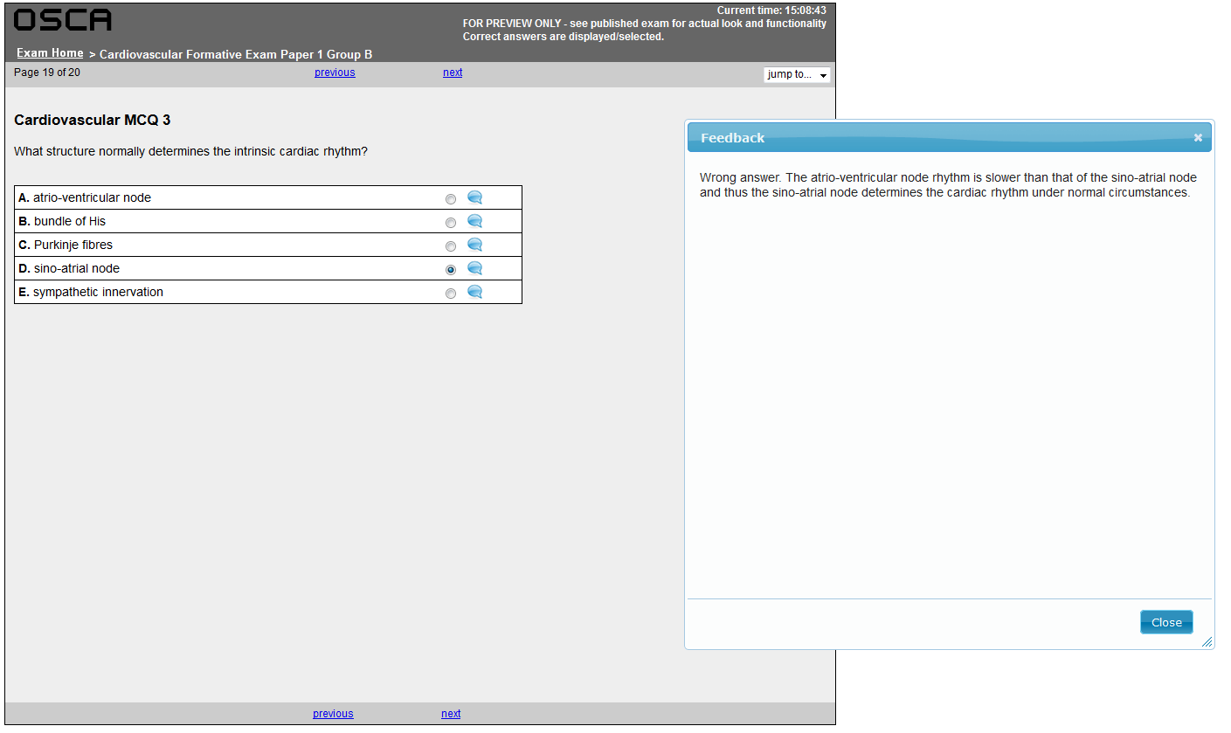
Evaluating two feedback mechanisms

Slide 14
Evaluating two feedback mechanisms
Tag | Score | Average | Max
Cardiovascular | 42 | 38 | 50
Biomedical Sciences | 42 | 38 | 50
Presentation Diagnosis and Management | 23 | 25 | 31
Clinical pharmacology and therapeutics | 25 | 19 | 25
Anatomy | 9 | 9 | 9
Physiology | 28 | 22 | 28
Pathology | 8 | 11 | 16
Chest pain | 3 | 2 | 3
Congenital Heart Disease | 8 | 11 | 16
Lipids | 3 | 3 | 3
Biochemistry | 19 | 13 | 19
ECG | 9 | 9 | 9

Slide 15
Evaluating two feedback mechanisms
Students performed similarly on the follow up formative exam
OSCA-FM 73.0
Tagging 68.8
Previous cohort 69.5
No significant differences on this or final cardiovascular exam performance after controlling for prior academic ability

Slide 16
What I learned
Students cannot accurately self-rate the EFFECTIVENESS of feedback
Personalised feedback significantly increases student satisfaction and well-being
Students cannot improve performance without focusing on metacognitive skills
BUT most students believe their metacognitive skills are fine

Slide 17
Further work
We saved a significant sum when the year 1 cardiovascular module released their questionbank to us
We tackled two new topics with the extra funds:
What do other UK institutions – with significantly higher feedback ratings – do?
What do our (practicing UK) graduates think of our feedback, looking back on the Edinburgh experience?

Slide 18
Background
Graduated from University of Edinburgh 2007 with an MA (Hons) degree in Psychology and Sociology
Coaching and mentoring role in private sector
Graduated from Edinburgh Napier University in 2012 with BN in Adult Nursing.

Slide 19
Edinburgh Graduates
What is good feedback – to a graduate?
How to prepare for the junior doctor years
How feedback can be improved in light of practise

Slide 20
Graduate Findings
Overall positive experience
“The course prepared me to be a lot more than an FY1. It prepared me to almost be a registrar”
“I think from the clinical perspective formative feedback is fairly lacking”
“From the time that I failed the [finals] I felt I got support in terms of feedback”

Slide 21
OSCE Survey Project
Audit of UK medical schools
Use of written/formative feedback
Use of supporting exam software

Slide 22
OSCE Survey Project Findings
17 of 31 schools responded
Big variation in feedback usage
1 school gave no formative OSCE feedback
Some of the highest rated for feedback gave very little formal feedback

Slide 23
Conclusions
Feedback increases student happiness, but engagement with metacognitive skills is required to increase performance
At-risk students struggle with metacognitive skills
Many staff practices are unhelpful, and cause distress among students: we can fix this while trying to improve the quality of feedback
“Poor” feedback goes beyond the academic: many places that give objectively poor feedback get excellent ratings!

