Slide 1
To the Staff-Student Cup and beyond: lessons in community building from HCA
Esther Mijers

Slide 2
The problem
HCA Community, or lack of
Lack of awareness of what is going on
Always the same students
NSS…

Slide 3
Areas for improvement
Communication
Bringing students into the School
Have more fun!

Slide 4
Actions so far
Deputy UGD
Student ambassadors
HCA Recognition celebration
New Year’s reception for finalists
Staff Student Cup (SPA)
School experience consultation with students
Students on SMC
Student rep system

Slide 5
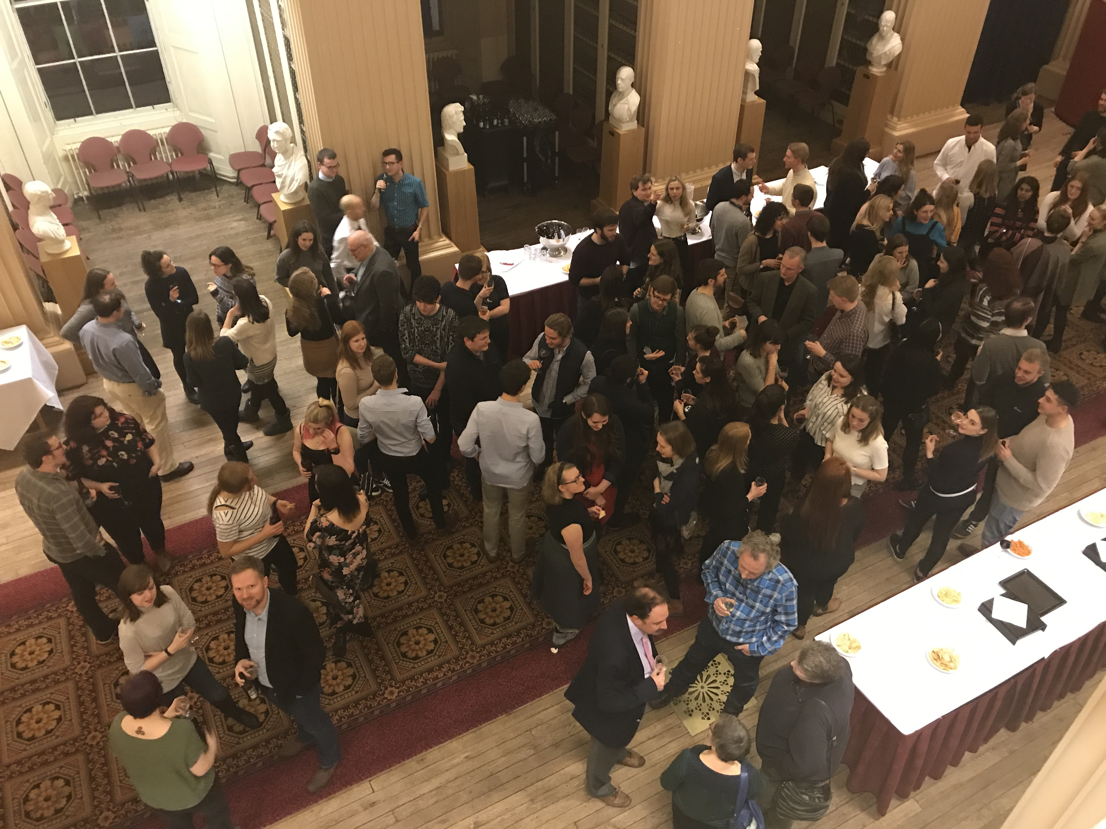
Successes
Ambassadors
Excellent relationship with the societies
  Curating History
  SRS theme
  Archaeology heritage day
Staff Student Cup
Improved awareness of School events

Slide 6

But…
Community still not there
  Work on programme level
Communication
  Improved website, screens
  School handbook
Still largely reach the same students
  The unsolvable puzzle??

