Slide 2
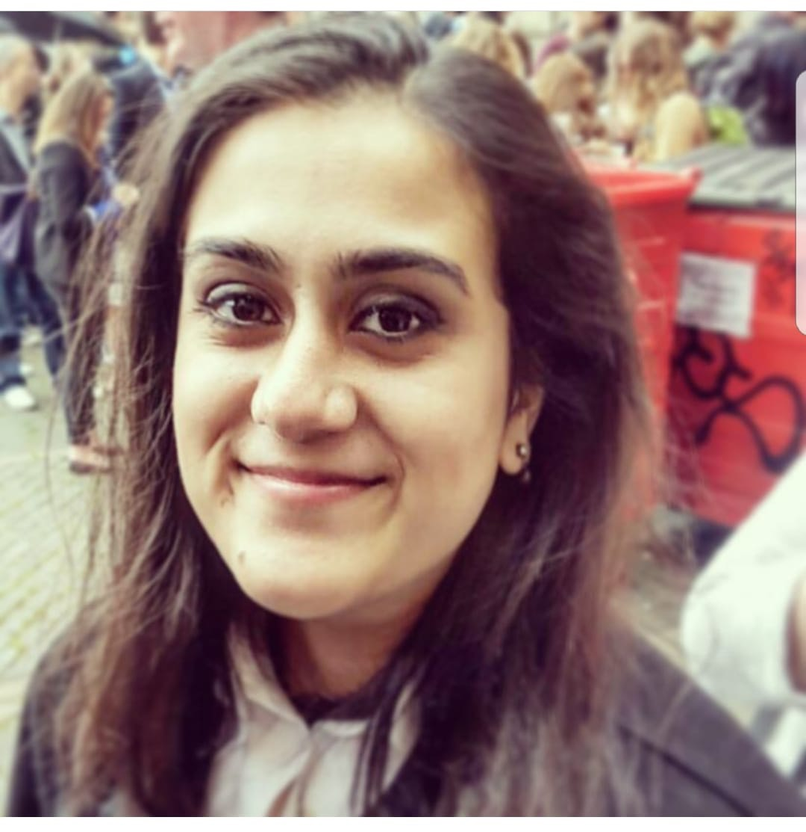
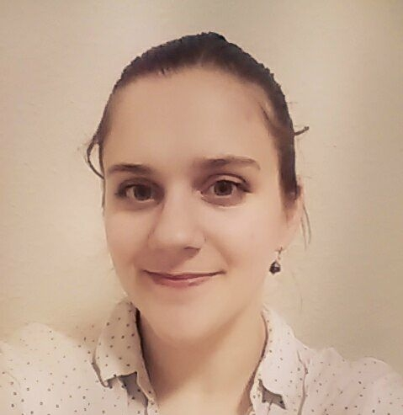
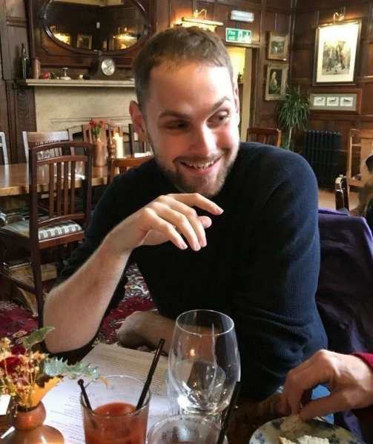
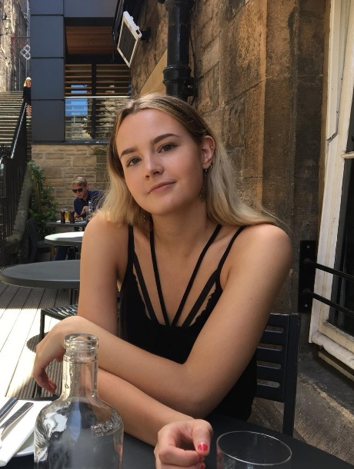
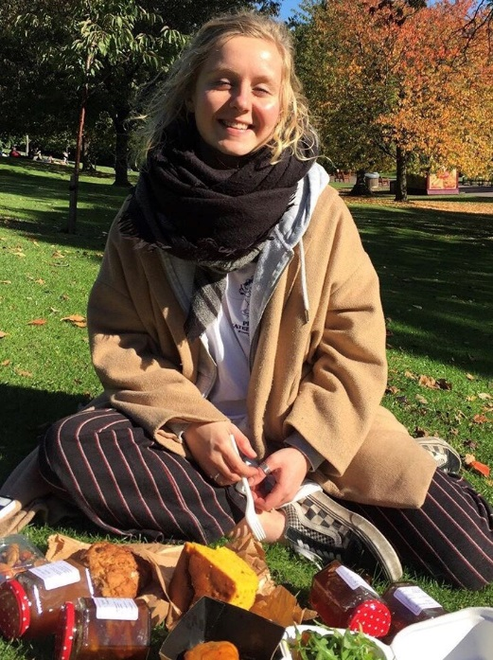
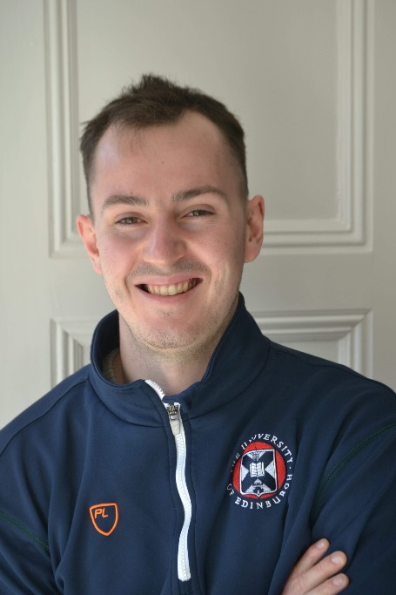
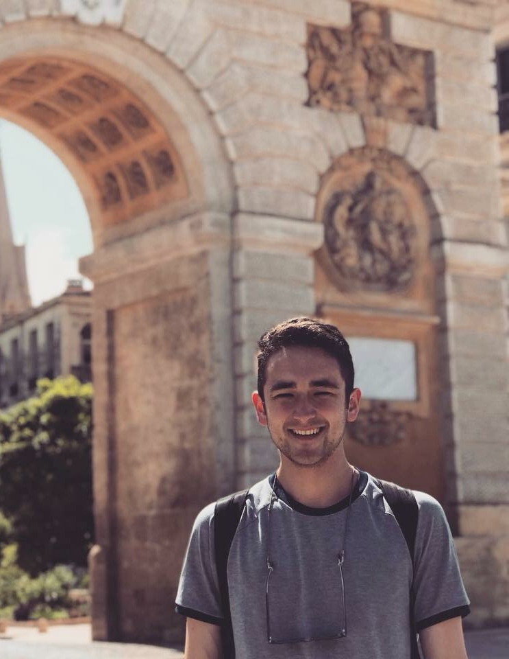
MEET THE TEAM

Slide 3
Aims of the Student Partnership Agreement
Notes:
Why the project was important to us - experience in these areas
All agreed that the 3 things were interlinked
By strengthening the student voice and enhancing academic support, we can promote positive mental health and well being

Slide 4
What was Chemistry already doing right?
Dedicated personal tutor
Social space
Integration between years: Chemsoc, AcFams
Notes:
Student satisfaction surveys: Edinburgh came 136th this year (v. low – down the bottom end), with 77% satisfaction on average, Chemistry has 80-87% student satisfaction, has been voted EUSA Teaching Awards BEST DEPARTMENT twice
What are we doing right?
If you read through the stats, Chemistry students generally felt that there was more of a community/that they got better guidance from staff
WHY? – PT, Social space
School of chem: so many people under one roof

Slide 5
Expanding the Chemunity
Casual interaction between staff and students, including postgrads
Normalise conversation surrounding SPA themes
Make it easier to find useful information, help and resources
Notes:
More opportunity to integrate – staff, students POSTGRADS important – maybe feel a little less part of things

Slide 6
SPA spending – a three part plan
Launch event
web resource
Building for the future
Notes:
Launch event – collect information, raise awareness
Web resource – to address feedback
Make something self-sustaining

Slide 7
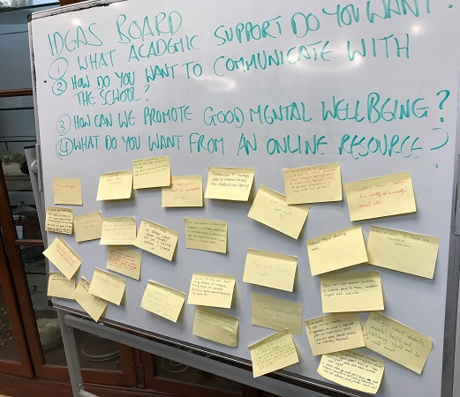
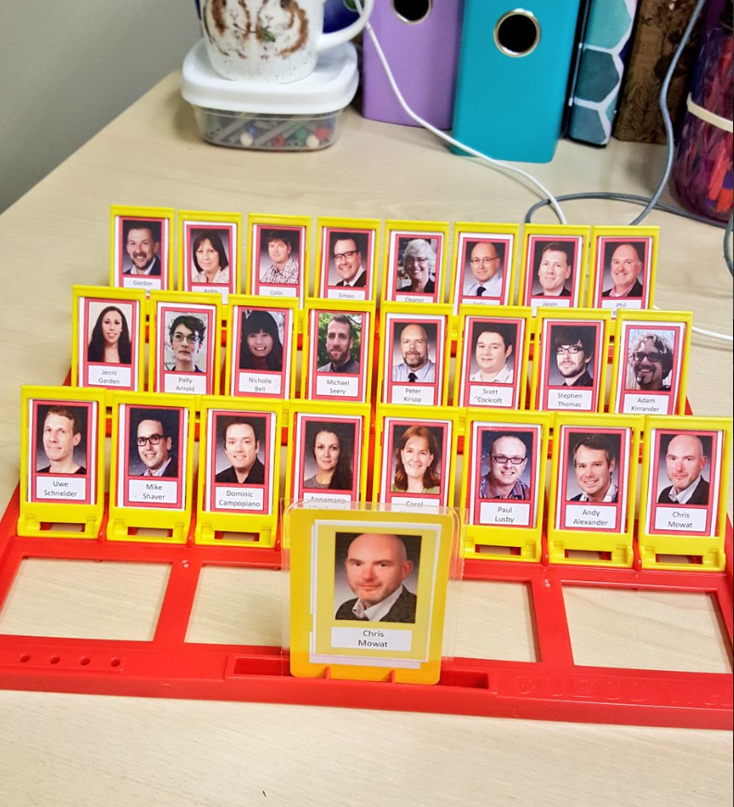
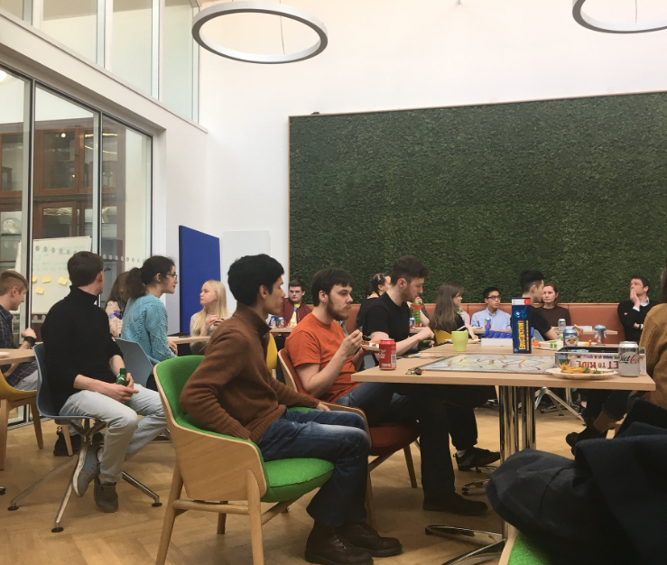
Launch Event Gathering opinions and raising awareness
Social space, food, board games
Asked general questions about SPA themes
Feedback on sticky notes
Notes:
Aims: gather students and staff in an informal setting
SPENDING: mainly food – worth it as we got a really good turnout (>50 students)
Board games – resources that can be used in the future
Andy Shanks, director of student wellbeing, was in attendance and telling us about some things that he’s doing
Large volume and variety of feedback
Worth noting: lots of feedback received verbally – shows how important these kind of events are: face to face communication

Slide 8
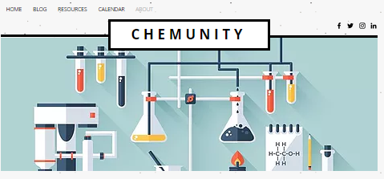
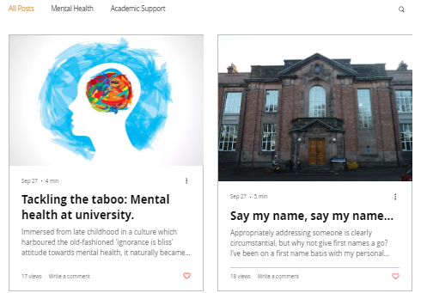
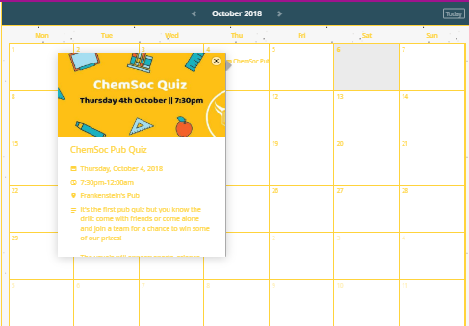
Website
Easy to use online resource which collates relevant information for chemistry students
Somewhere to share experiences
A place to address feedback
Notes:
Website aims (on slide):
Aimed to have this up and running by the end of June – overly ambitious
Started working with IT – very limited
Looked like Uni websites – what we wanted to move away from – since myed, learn, blackboard all very confusing
Moved away – started using wix free software, easier to edit and add features, got a place to leave feedback that will be monitored, can start to make out own resources to put on there
Blog posts as a way to share experience and as academic resources
Place for people to leave comments which we can monitor
Calendar of events
Now it is easy to edit we can add features to address what feedback we’ve received

Slide 9
Building for the future
Addressing feedback in novel ways
Developing and maintaining the web resource
Expanding beyond Chemunity
… Keep breaking down barriers and making bonds
Notes:
Lots of feedback – didn’t know what to with it, also focused on getting website up and running
Divided into SPA themes, split up into ‘what we can address immediately, what we need staff to help with’ – can start to address specifics
Website up – will come up with novel ways of addressing feedback through this + add features which will make it easier for the student voice to be heard – advertise it with
Events to keep promoting a sense of community
Collabs within the school of chemistry: ties to chemsoc and acfams (teastress) – promote each others events etc (chemunity good compliment to these as not centred around drinking culture and extends to PGs)
Collabs with other initiatives to expand beyond school of chemistry – WellComm, NHS Training, Peer support training – we’re making ourselves better able to assist others…
Seeking funding from elsewhere to keep on doing our thing

Slide 10
Resources
Social media
Notice board – topical displays
Semester 1 events:
Board game evenings
Chemunity pub quiz – Friday 18th January, Mayfield Rm, KB House
Resilience workshops – UoE mental health week
Decompression session
End of semester stress buster – throughout November
Exam pack for Chemistry students
Notes:
Social media regularly posting – not just stuff about Chemunity – keep it up as interesting page to follow as well as a place to advertise
Notice board: advertise events, keep updating display – Things to put up there: Inspirational quotes by famous scientists, topical displays e.g. Ada Lovelace Day display, fun things to use/play with e.g. origami paper
Keep using board games – ongoing resource promotes community
Calendar of semester 1 events (and more will come in semester 2) - also support for WellComm’s speakeasies etc
End of semester stress buster over a few weeks – ideas for different ways to manage stress – free yoga (Anne Brown in the office), crafts (gingerbread man decorating, colours/dress from your country – internationalisation team up/funding), throwing paint balloons, safe space for ranting….
Accompanied by an exam survival pack that we will make for chemistry students – currently working out what funding we can get for this
End with a staff talent / 5th year show in school of chemistry – will be a hilarious way to bring everyone together at the end of the semester

Slide 11
Mission success?
Lessons learned:
Impact:
Immediate
Chemunity team expanding
New school initiative to support PGs
Future
Succession planning – Chemunity will continue
Potential for huge impact in future
Food is expensive but increases attendance
People don’t know what information is out there
Providing info in a single place is an enormous task
Easy to be overly-ambitious
Notes:
LESSONS:
For lots of questions asked/things people wanted to know about there’s information already out there – general lack of awareness about what academic support etc they’re entitled to – Supportive information is not reaching its recipient
This huge span of feedback received from just ~50 people made us realise what a huge task it is going to be to put everything into one place
It was easy to be over ambitious – website by the end of June was impossible, only just started to figure out how to start addressing specific feedback, whole process is going to be much slower than we thought.
IMPACT:
More people hearing about and becoming interested in Chemunity (including people who feel a bit left out of the culture associated with chemsoc/acfams – an alternative place for them to go to meet people) WORD IS SPREADING
Chemunity used as an example of how the university can support researchers with their mental wellbeing – Dr Sara Shinton & Michael Seery → Feeding into new support systems for PGs – research and mental health day
Future:
Chemunity team spans across years – when people graduate will pass down to younger people, means that the initiative can be ongoing – self-sustaining… Been seeking our own funding from other places – expand beyond what is achievable with the SPA grant
Enormity of task means that impact/importance of the initiative can be great and something the rest of the University can learn from, collabs with other people = SHARING INFORMATION – we’re all working towards a common goal

Slide 12
Energy Barrier
Starting material
COMMUNICATION
COLLABORATION
SoC
UoE
A thermodynamically stable academic environment
Products
Notes:
1: If this is energy: In any chemical reaction – starting material and products, energy barrier you must get over – need to put something in to get something out
2: SM is School of Chemistry – confused, unsure students
3: Product = stable academic environment – happy students who know whats going on
4: What’s going to get us over the barrier?? – CHEMUNITY: students putting in THEMSELVES to overcome barriers
5: Chemistry is already doing some things right in terms of community, so thinking about the wider university – bit of a bigger job – obstacles are larger BUT IF WE KEEP COMMUNICATING AND COLLABORATING, WE CAN ALL WORK TOWARDS THIS GOAL.

