Slide 1
Planning to improve feedback and assessment
Edinburgh University
14 September 2016
Sally Brown
@ProfSallyBrown sally@sally-brown.net
NTF, PFHEA, SFSEDA
Emerita Professor, Leeds Beckett University
Visiting Professor University of Plymouth, University of South Wales & Liverpool John Moores University.

Slide 2
Focus of this workshop
Assessment and feedback NSS scores at Edinburgh university tend to be below the sector average and in many cases are getting worse year on year (with some honourable exceptions);
While assessment and feedback scores tend to be worse in most HEIs than other areas, these are still below average for the sector;
NSS scores, whether we like it or not, are likely to increase in the impact they have on the way any university is perceived, particularly after the implementation of TEF;
Enhancing assessment and feedback needs to be an urgent priority.

Slide 3
What needs to be done?
It is possible to improve NSS scores on assessment and feedback and many universities are working hard on this;
Improving the quality, amount, scope, language and nature of feedback is the most powerful means of improving students’ perceptions of assessment;
Alongside this, a course-wide review of assessment, from planning, implementation, moderation and evaluation is essential;
There are no quick fixes but there can be some quick wins;
Students care deeply about justice, integrity and respect in relation to assessment.

Slide 4
The assessment context has changed
Three decades of international research into assessment and feedback in higher education has given us a sound evidence-based foundation for us to use in designing assessment strategies;
There is always a trade-off between making assessment manageable in terms of staff time and energy, and the 21st century expectation that assessment must be for not just of learning;
In assessment and feedback, it isn’t enough to simply keep doing what you’ve always done, since expectations are constantly increasing and your competitors are steadily improving.

Slide 5
Using assessment for learning (Sambell et al, 2012)
Assessment that is meaningful to students can provide them with a framework for activity;
“Students can escape bad teaching but they can’t escape bad assessment” (Boud, 1995);
Where assessment is fully part of the learning process and integrated within it, the act of being assessed can help students make sense of their learning;
Assessment should be formative, informative, developmental and remediable.

Slide 6
A4L the Northumbria model
Emphasises authentic & complex assessment tasks
Develops students’ abilities to evaluate own progress, direct own learning
Is rich in informal feedback (e.g. peer review of draft writing, collaborative project work)
Uses high stakes summative assessment rigorously but sparingly
Offers extensive ‘low stakes’ confidence building opportunities and practice
Is rich in formal feedback (e.g. tutor comment, self-review logs)

Slide 7
Assessment for learning
1. Tasks should be challenging, demanding higher order learning and integration of knowledge learned in both the university and other contexts;
2. Learning and assessment should be integrated, assessment should not come at the end of learning but should be part of the learning process;
3. Students are involved in self assessment and reflection on their learning, they are involved in judging performance;
4. Assessment should encourage metacognition, promoting thinking about the learning process not just the learning outcomes;
5. Assessment should have a formative function, providing ‘feedforward’ for future learning which can be acted upon. There is opportunity and a safe context for students to expose problems with their study and get help; there should be an opportunity for dialogue about students’ work;

Slide 8
Assessment for learning
6. Assessment expectations should be made visible to students as far as possible;
7. Tasks should involve the active engagement of students developing the capacity to find things out for themselves and learn independently;
8. Tasks should be authentic; worthwhile, relevant and offering students some level of control over their work;
9. Tasks are fit for purpose and align with important learning outcomes;
10. Assessment should be used to evaluate teaching as well as student learning.
(Bloxham and Boyd)

Slide 9
Designing fit-for-purpose assessment methods & approaches: 10 questions
Are your assignments fully and constructively aligned with your learning outcomes?
Do they comply with your university requirements in terms of format, number, word limits etc?
Are summative assessments undertaken throughout the course, or is everything ‘sudden death’ end-point?
Is there excessive bunching of assignments in different modules that is highly stressful for students and unmanageable staff?
Are there plenty of opportunities for formative assessment, especially early on in the programme?

Slide 10
And the next five:
Are students over-assessed?
Do staff have time to mark the assessments in time for moderation etc.?
When you have introduced innovative assignments, have they been introduced instead of existing ones or simply added to the assessment diet?
Are students encouraged to make good use of the feedback they receive?
Do the students perceive your assessment diet to be fair and providing meaningful recognition of their achievements?

Slide 11
Good feedback: (after Brown, S. (2015), Assessment, learning and teaching in higher education: global perspectives, London: Palgrave-MacMillan)
Is dialogic, rather than mono-directional, giving students chances to respond to comments from their markers and seek clarification where necessary.
Helps clarify what good work looks like, so students are really clear about goals, criteria and expected standards, and provides opportunities to close the gap between current and desired performance.

Slide 12
Good feedback:
Actively facilitates students reviewing their own work and reflecting on it, so that they become good judges of the quality of their own work.
Doesn’t just correct errors and indicate problems, potentially leaving students discouraged and demotivated, but also highlights good work and encourages them to believe they can improve and succeed.

Slide 13
Good feedback:
Delivers high-quality information to students about their achievements to date and how they can improve their future work. Where there are errors, students should be able to see what needs to be done to remediate them, and where they are undershooting in terms of achievement, they should be able to perceive how to make their work even better.

Slide 14
Good feedback:
Offers ‘feed-forward’ aiming to ‘increase the value of feedback to the students by focusing comments not only on the past and present … but also on the future – what the student might aim to do, or do differently in the next assignment or assessment if they are to continue to do well or to do better’ (Hounsell, 2008, p.5).
Ensures that the mark isn’t the only thing that students take note of when work is returned, but that they are encouraged to read and use the advice given in feedback and apply it to future assignments.

Slide 15
The importance of dialogic feedback (Sadler)
Students need to be exposed to, and gain experience in making judgements about, a variety of works of different quality... They need planned rather than random exposure to exemplars, and experience in making judgements about quality. They need to create verbalised rationales and accounts of how various works could have been done better. Finally, they need to engage in evaluative conversations with teachers and other students.

Slide 16
Five things students really hate about feedback
Vague comments which give few hints on how to improve or remediate errors: ‘OK as far as it goes’, ‘Needs greater depth of argument’, ‘Inappropriate methodology used’, ‘Not written at the right level’.
Feedback that arrives so late that there are no opportunities to put into practice any guidance suggested in time for the submission of the next assignment.

Slide 17
Things students really hate about poor feedback
Poorly written comments that are nigh on impossible to decode, especially when impenetrable acronyms or abbreviations are used, or where handwriting is in an unfamiliar alphabet and is illegible.
Cursory and derogatory remarks that leave them feeling demoralised ‘Weak argument’, ‘Shoddy work’, ‘Hopeless’, ‘Under-developed’, and so on.
Value judgements on them as people rather than on the work in hand.

Slide 18
Making assessment work well
Intra-tutor and Inter-tutor reliability need to be assured;
Practices and processes need to be transparently fair to all students;
Cheats and plagiarisers need to be deterred/punished;
Assessment needs to be manageable for both staff and students;
Assignments should assess what has been taught/learned not what it is easy to assess;
Assessment should use formats that fit the purpose and the context.

Slide 19
Can we provide opportunities for staged assessment?
Consider allowing resubmissions of work as part of a planned programme early on;
Students often feel they could do better once they have seen the formative feedback and would like the chance to have another go;
Particularly at the early stages of a programme, we can consider offering them the chance to use formative feedback productively;
Feedback often involves a change of orientation, not just the remediation of errors.

Slide 20
Encouraging students to recognise and use the feedback we provide for them
Delivery of feedback should not be left to chance, so its best to avoid asking students to pick up marked hard copy assignments from departmental offices;
Electronic submission of assignments has benefits and disadvantages but on balance the former outweigh the latter;
Perhaps require students to guestimate expected marks having read your feedback early in their programmes;
‘Assignment handler’ can deliver feedback electronically and only release marks once students have responded;
Audio files of audio feedback can be highly successful in enabling students to capture ‘live’ oral feedback, and can replace written feedback (e.g. JISC project ‘Sounds good’).

Slide 21
To better engage learners we can:
Make use of real examples and hot-off-the-press data to keep content current;
Give added-value to students who engage. Provide resources and text on-line that back up classroom activities (including audio/video recordings of your lectures) without ever letting it be perceived that this is a substitute for being there!
Provide challenges to students’ thinking without letting individuals feel publicly exposed or humiliated;
Relate their work to the forthcoming/ongoing assignment (without slavishly teaching to the exam);
Make spaces for dialogue, through clickers/ Twitter/ whatever, live and after the session.

Slide 22
Do your international students understand UK assessment approaches?
Have you clarified the ground rules on issues like pass marks, criterion-referenced assessment and grading systems?
Have you explained how extensions, condonements, and university assessment regulations work?
Are the assignments built around a curriculum international in scope and content? Are tasks and case studies globally orientated?

Slide 23
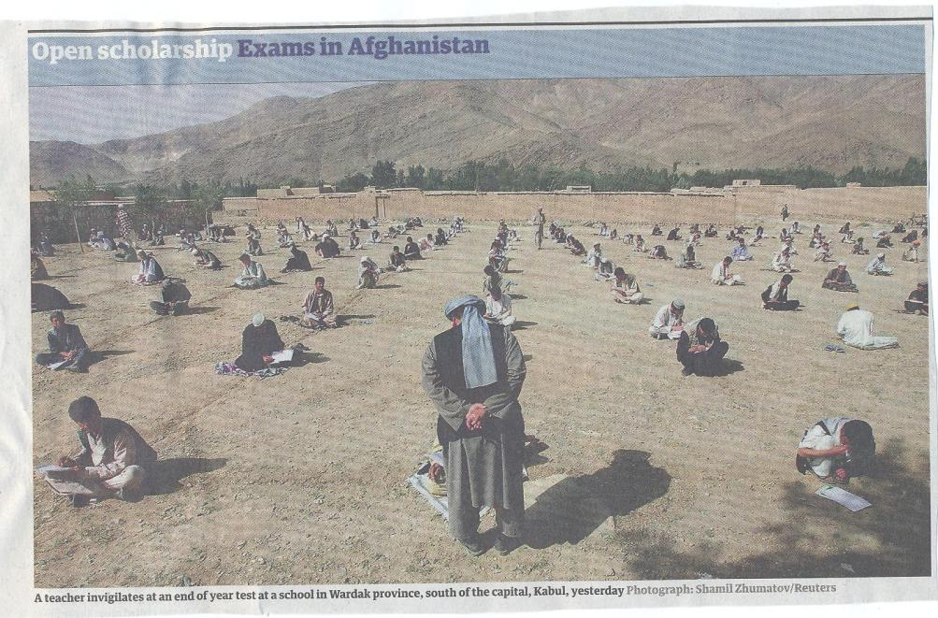

Slide 24
Some thoughts on assessment and feedback
Academic staff frequently use a fairly limited range of assessment and feedback methods for individuals and groups, but international pedagogic research suggests that diversity benefits students greatly.
To maximise the benefits of formative feedback, a range of streamlined approaches including statement banks and computer based assessments can supplement traditional forms.
Students do not always recognize or use feedback well, but assessment dialogues can enhance learning.

Slide 25
Assessment literacy: students do better if they can:
Make sense of key terms such as criteria, weightings, and level;
Encounter a variety of assessment methods (e.g. presentations, portfolios, posters, assessed web participation, practicals, vivas etc) and get practice in using them;
Be strategic in their behaviours, putting more work into aspects of an assignment with high weightings, interrogating criteria to find out what is really required and so on;
Gain clarity on how the assessment regulations work in their HEI, including issues concerning submission, resubmission, pass marks, condonement etc.

Slide 26
Peter Hartley’s NTFS Bradford-led project on Programme Level Assessment
It set out to focus on redressing problems including:
not assessing learning outcomes holistically at a programme level;
the atomisation of assessment, often resulting in too much summative and not enough formative feedback and over-standardisation in regulations.
This results in students and staff failing to see the links between disparate elements of the programme, over-assessment and multiple assignments using repetitive formats.
Modules were often too short for complex learning and this tended to lead to surface learning and ‘tick-box mentality.

Slide 27
Strategies to implement assessment for learning in universities
Course leaders and others can impact positively on the assessment context by:
Reviewing student experiences of assessment and feedback, (not just through NSS) and seeking opportunities for enhancement;
Providing opportunities for colleagues to share their own good practice together with staff development on innovations (what can you learn from colleagues here who have improved assessment and feedback scores in recent years?).

Slide 28
To better engage learners through feedback and assessment we can:
Make use of real examples and hot-off-the-press data to keep content and tasks current and relevant;
Provide challenges to students’ thinking without letting individuals feel publicly exposed or humiliated;
Relate their learning in class to the forthcoming/ongoing assignment (without slavishly teaching to the exam);
Make spaces for dialogue through formative assessment;
Give them real problems to solve and issues with which to engage;
Identify the skills they need to succeed and provide opportunities to rehearse and develop them;
Never compromise on the quality of the demands we make of them.

Slide 29
Conclusions
Assessment can be a powerful means of focusing student effort and enhancing achievement if it is well designed and constructively aligned (Biggs and Tang, 2007);
Students in the early stages of their learning journey are likely to need more support and positive feedback than later, when they are more robust and confident;
The first six weeks of the first semester are crucial in helping students understand how assessment works;
No single method of assessment or giving feedback is likely to be ubiquitously successful, so it’s worth using a variety of approaches;
Assessment needs to be manageable for staff and students if it is going to engage students in learning activities.

Slide 30
These and other slides will be available on my website at http://sally-brown.net

Slide 31
Useful references and further reading (1)
Bain, K. (2004) What the best College Teachers do, Cambridge: Harvard University Press.
Biggs, J. and Tang, C. (2007) Teaching for Quality Learning at University, Maidenhead: Open University Press.
Bloxham, S. and Boyd, P. (2007) Developing effective assessment in higher education: a practical guide, Maidenhead, Open University Press.
Boud, D. (1995) Enhancing learning through self-assessment, London: Routledge.
Brown, S. and Glasner, A. (eds.) (1999) Assessment Matters in Higher Education, Choosing and Using Diverse Approaches, Maidenhead: Open University Press.
Brown, S. and Race, P. (2012) Using effective assessment to promote learning in Hunt, L. and Chambers, D. (2012) University Teaching in Focus, Victoria, Australia, Acer Press. P74-91.
Brown, S. (2015) Learning , Teaching and Assessment in Higher Education: Global perspectives, London, Palgrave.

Slide 32
Useful references and further reading (2)
Carless, D., Joughin, G., Ngar-Fun Liu et al (2006) How Assessment supports learning: Learning orientated assessment in action Hong Kong: Hong Kong University Press.
Carroll, J. and Ryan, J. (2005) Teaching International students: improving learning for all. London: Routledge SEDA series.
Crosling, G., Thomas, L. and Heagney, M. (2008) Improving student retention in Higher Education, London and New York: Routledge
Crooks, T. (1988) Assessing student performance, HERDSA Green Guide No 8 HERDSA (reprinted 1994).
Falchikov, N. (2004) Improving Assessment through Student Involvement: Practical Solutions for Aiding Learning in Higher and Further Education, London: Routledge.
Gibbs, G. (1999) Using assessment strategically to change the way students learn, in Brown S. & Glasner, A. (eds.), Assessment Matters in Higher Education: Choosing and Using Diverse Approaches, Maidenhead: SRHE/Open University Press.
Higher Education Academy (2012) A marked improvement; transforming assessment in higher education, York: HEA.

Slide 33
Useful references and further reading (3)
McDowell, L. and Brown, S. (1998) Assessing students: cheating and plagiarism, Newcastle: Red Guide 10/11 University of Northumbria.
Meyer, J.H.F. and Land, R. (2003) ‘Threshold Concepts and Troublesome Knowledge 1 – Linkages to Ways of Thinking and Practising within the Disciplines’ in C. Rust (ed.) Improving Student Learning – Ten years on. Oxford: OCSLD.
Nicol, D. J. and Macfarlane-Dick, D. (2006) Formative assessment and self-regulated learning: A model and seven principles of good feedback practice, Studies in Higher Education Vol 31(2), 199-218.
PASS project Bradford http://www.pass.brad.ac.uk/ Accessed November 2013.
Peelo, M. T., & Wareham, T. (Eds.). (2002). Failing students in higher education. Society for Research into Higher Education.
Pickford, R. and Brown, S. (2006) Assessing skills and practice, London: Routledge.
Rotheram, B. (2009) Sounds Good, JISC project http://www.jisc.ac.uk/whatwedo/programmes/usersandinnovation/soundsgood.aspx

Slide 34
Useful references and further reading (4)
Race, P. (2001) A Briefing on Self, Peer & Group Assessment, in LTSN Generic Centre Assessment Series No 9, LTSN York.
Race P. (2015) The lecturer’s toolkit (4th edition), London: Routledge.
Rust, C., Price, M. and O’Donovan, B. (2003) Improving students’ learning by developing their understanding of assessment criteria and processes, Assessment and Evaluation in Higher Education. 28 (2), 147-164.
Ryan, J. (2000) A Guide to Teaching International Students, Oxford Centre for Staff and Learning Development.
Stefani, L. and Carroll, J. (2001) A Briefing on Plagiarism http://www.ltsn.ac.uk/application.asp?app=resources.asp&process=full_record&section=generic&id=10
Sadler, D. Royce (2010) Beyond feedback: developing student capability in complex appraisal, Assessment & Evaluation in Higher Education, 35: 5, 535-550.
Yorke, M. (1999) Leaving Early: Undergraduate Non-completion in Higher Education, London: Routledge.

