Slide 1
Caring Research for a Caring Place Researchers in Care Homes: Nuisance or Necessity?
Dr Julie Watson
University of Edinburgh
ECRED/Nursing Studies
Notes:
My background is hospice nursing. I got interested in care homes
through working on a research project to develop palliative and end of life care in care homes. That led on to developing interests in research on dementia care in care homes and I see research as a natural part of my caring role.

Slide 2
Overview of next 10 minutes
Examples of two care home research projects
What the projects were about
Key findings
Consider which aspects were a nuisance and which a necessity

Slide 3
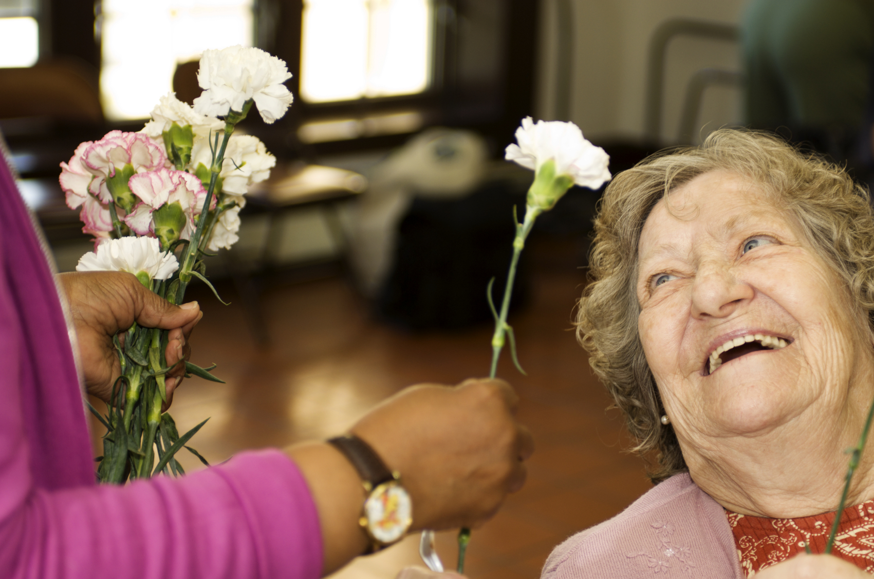
Example 1 (Image purchased from iStock with permission to use)
Aim: To understand how care staff and people with advanced dementia relate to each other in a care home
What I did..
10 months observing and working alongside staff in one care home
24 interviews with staff
3 group discussions with staff
Notes:
With the aim of understanding how best to support relationship centred care

Slide 4
Key findings
People with advanced dementia are actively engaged in relationships until the end of life.
The importance of non-verbal communication and interaction.
Hands-on bodily care of people with advanced dementia is complex and key to relationships.
Feelings of residents and staff are interconnected
Notes:
More detailed findings are here which I will hand out and also there is a reference to a journal article at the end.

Slide 5
Nuisance?
Necessity?

Slide 6
Nuisance - to residents and families
This is their home
Capacity issues
Taking staff away from residents
Intrusive – ethical issues – invasion of privacy

Slide 7
Nuisance – to the staff
Staff feeling watched
Trust – worries about researcher seeing things that are wrong
Taking up staff’s time when busy
No benefit to the care home in the short term
Notes:
Do have a duty to report poor care

Slide 8
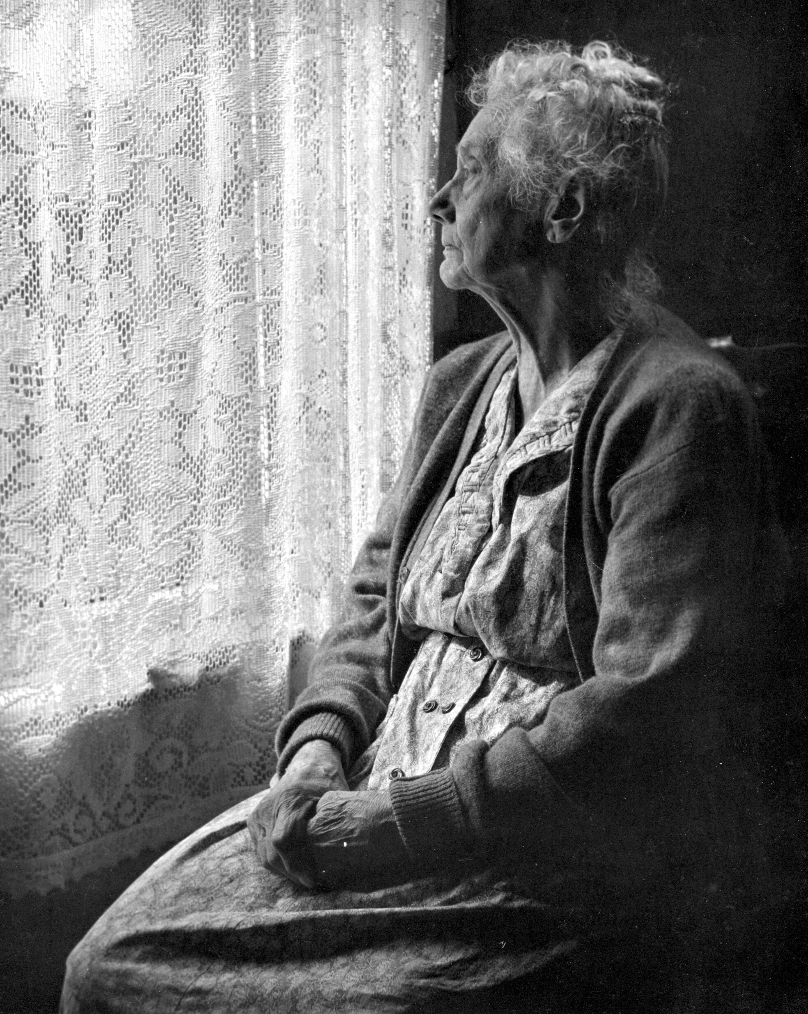
Necessity
People with advanced dementia can be seen as ‘already dead’
Expertise in care homes we can learn from
Some care homes struggle - what works?
Evidence base of care home care and dementia care needs further developed - care homes are also work places and regulated care providers
Notes:
Those findings I mentioned might seem obvious to you but we can’t assume that others who are also part of the caring process do know - politicians, care commissioners etc. empirical research is needed to articulate it - they need to hear how complex hands –on care is – this has implications for staffing levels and staff development – the fact that the feelings of staff and residents are interconnected has implication for the type of support staff get day to day with this very emotional work

Slide 9
Example 2
Aims
To explore student nurses’ attitudes towards care home nursing and their knowledge of, educational opportunities within the care home setting.
What we did…
Focus groups with 36 student nurses at University of Edinburgh
Making a short film about care home nursing with students

Slide 10
Key Findings
Student nurses:
don’t consider care home nursing a good career
influenced by negative media stories
think they will ‘lose clinical skills’ AND ‘have too much responsibility
need to know more about and hear positive stories about care home nursing

Slide 11
Nuisance?
Necessity?

Slide 12
Nuisance
Asking students to give of their time for a focus group (with lunch!)
Asking students to volunteer time to make a film
Asking care home nurses to volunteer time to be interviewed and filmed

Slide 13
Necessity
There is a recruitment and retention crisis in care home nursing
Most student nurses training in acute care
3 times as many care home beds as acute NHS
By 2040 care homes are projected to be the most common place of death (Bone et al 2017)
Notes:
It needs to be on the curriculum and we need research evidence to back up why that is so we make the case

Slide 14
Summary and Conclusion
Described two examples of care home research
Illustrated the tension between research as a nuisance and a necessity
Conclusion
Despite the nuisances, research is a necessary part of the caring process that enables care homes to be caring places.

Slide 15
References
Bone, A.E., Gomes, B. Etkind, et al (2017) What is the impact of population ageing on the future provision of end-of-life care? Population-based projections of place of death Palliative Medicine DO1:1077/0269216317734435https
Watson, J. (2016) Developing the Senses Framework to support relationship-centred care for people with advanced dementia until the end of life in care homes Dementia DOI: 10.1177/1471301216682880 online
Watson, J (2016) Face to Face: Relating to people with dementia until the end of life in care homes http://hdl.handle.net/1842/16876

Slide 16
Julie.Watson@ed.ac.uk All images (except iStock purchase on slide 3) from Google Image labelled with permission for reuse

