Slide 1
PTAS: Taking on the impact challenge
Roni Bamber, Queen Margaret University
PTAS, June 2015

Slide 2
Chair, Student Transitions Enhancement Theme
Aim: to enhance student learning through collaboration, sharing and learning across sector
Transitions in, through, out
3 year plan of work, Student Network, Institutional teams, Projects
Themes website with free resources
Notes:
Can we use the ideas from evaluation and evidencing literature to help us get reliable knowledge about our educational research?
Evaluation as social practice
As we noted in our opening chapter, this book recasts the idea of evaluation by conceptualising it as a ‘block’ or ‘cluster’ of practices concerning the attribution of value to ‘what we do’, in this case, in higher education. While this is the focus of this book, this perspective may apply equally to evaluative practice in any other public policy sphere.

Slide 3
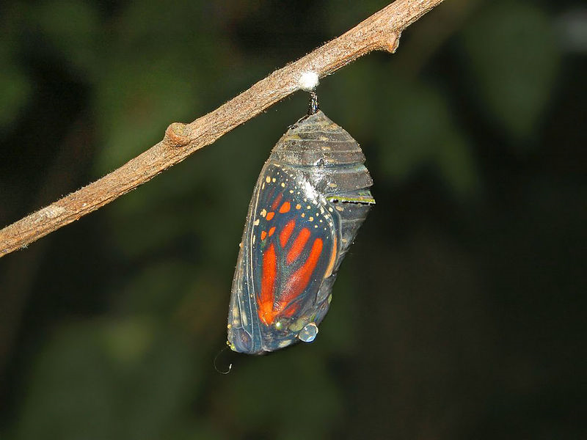
Student Transitions Focus
Transitions
Into HE
Through HE
Out of HE
http://commons.wikimedia.org/wiki/File:Nymphalidae_-_Danaus_plexippus_Chrysalis-1.JPG
Notes:
http://commons.wikimedia.org/wiki/File:Nymphalidae_-_Danaus_plexippus_Chrysalis-1.JPG

Slide 4
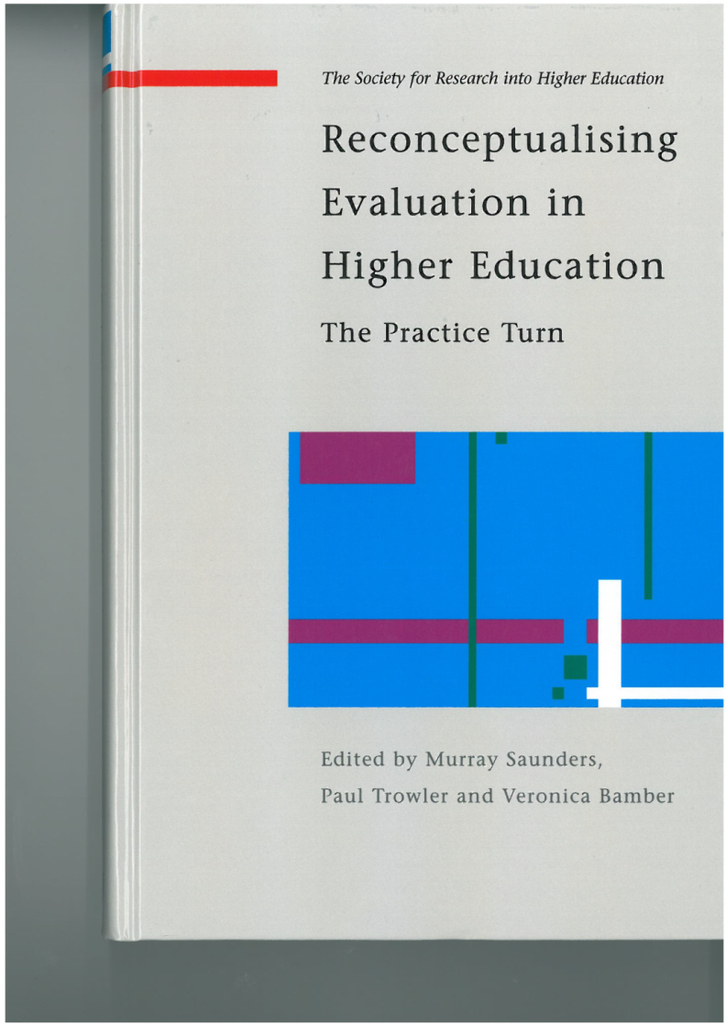
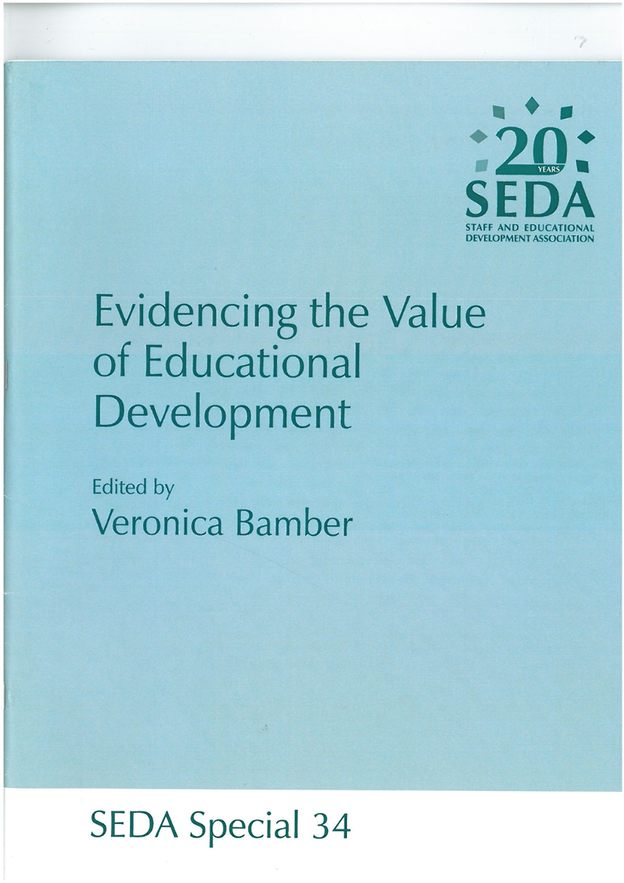
Evaluating – Evidencing
Notes:
Can we use the ideas from evaluation and evidencing literature to help us get reliable knowledge about our educational research?
Evaluation as social practice
As we noted in our opening chapter, this book recasts the idea of evaluation by conceptualising it as a ‘block’ or ‘cluster’ of practices concerning the attribution of value to ‘what we do’, in this case, in higher education. While this is the focus of this book, this perspective may apply equally to evaluative practice in any other public policy sphere.

Slide 5
My argument…
Let’s move from impact to evidencing value
Using multiple sources of evidence
Planning local evidence for local enquiry
Turning local evidence into scholarship
Making a difference to our local knowledge and practices

Slide 6
Better understandings, useful knowledge
‘Knowledge that you can do nothing with is no knowledge at all. And nothing is nothing, no matter how long you talk about it’ (Revans)

Slide 7
Making a difference…
How can we use the evidencing approach for evidence-informed critical inquiry into our practices?

Slide 8
And to demonstrate that we have…
enhanced the quality of the student learning environment through discipline-based pedagogical inquiry and research capacity building (PTAS, 2015)?
encouraged and supported activities that will make a significant contribution to the enhancement of learning and teaching at the University of Edinburgh, at both undergraduate and postgraduate level (PTAS, 2015)?

Slide 9
Aspect 1:
Let’s move from impact to evidencing value

Slide 10
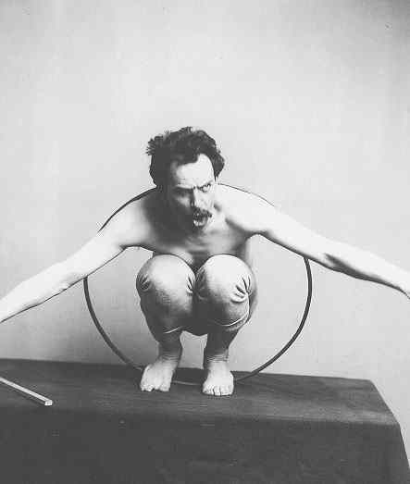
The problem with ‘impact’
Managerialism v education
Measurable targets
KPIs
Vfm
http://api.ning.com/files/W3YWqQ-JGjl6ASQ8CP3z4Olw4wN3ZRdaP42JFCfOcfTU1b2UbVAveF2zJfGBO2IcvMm9hj2qXXvIZyZK73TBtz4kd00oZDZv/boas.jpg

Slide 11
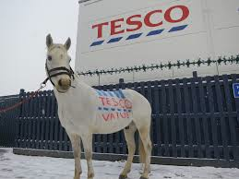

Slide 12
The problem with ‘impact’
Managerialism v education
Students and their learning
University experience
Educated
Notes:
http://www.shutterstock.com/en/pic.mhtml?id=156714224

Slide 13
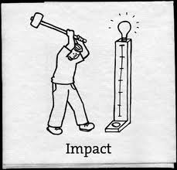
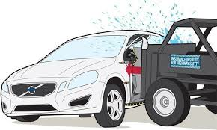
Impact:
Social world complexities / inquiry not normally amenable to demonstrating impact
Epistemologically positivist
Cause / effect: what we do in education?

Slide 14
‘Virtuous mess and wicked clarity’
Educational inquiry: messy
So - ground our evidencing work
‘in the realities of the social world, including the power relationships, the distortions and the pathologies that affect how we live’ (McArthur, 2012: 421)
Notes:
Jan McArthur (2012) talks about ‘virtuous mess and wicked clarity’ of theory, method and purpose in educational research. I would extend her idea to evidencing the value of educational development; if we want the kind of clarity which illuminates the real world and helps us understand it better, rather than clarity which distorts or falsifies by simplification, we need to work with the messiness of the social world that we inhabit. McArthur (2012: 421) says that, if we ignore this messiness, we can end up creating ‘bad mess’, which ‘might fit into neat results columns or statistics or tidy theory, but beneath the ‘proper’ exterior it is a deceit – a false clarity.’ We are enjoined to ground our educational research ‘in the realities of the social world, including the power relationships, the distortions and the pathologies that affect how we live’ (McArthur, 2012: 421). I couldn’t agree more. And this is where research can offer so much to the activity of evidencing value: in research, it is more likely that the social world will be acknowledged, and ‘what doesn’t work’ as well as ‘what works’ will be explored.
virtuous mess is mess that reflects or illuminates aspects of the social world as we really experience it and this may include the ‘indeterminate’ and ‘ambiguous’ that Hammersley warns against. Bad mess is quite simply the pickle we can get into when we try to tidy up the former. Seeking to force the inherently messy into a respectable tidy form can result in something that distorts, hides or falsifies the actual social world. This is the irony: that sometimes those who seek clarity, regarding it as a reasonably uncontested virtue, end up creating bad mess. It might fit into neat results columns or statistics or tidy theories, but beneath the ‘proper’ exterior it is a deceit – a false clarity.

Slide 15
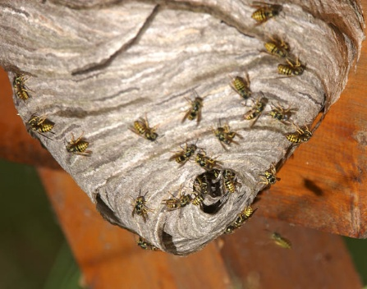
Making virtuous mess
Poking a stick into the nest of evidence, but with intentionality, (provisional) planning, an approach and principles
Notes:
Provisionality of truth
Embrace complexities
Multiple, contested meanings

Slide 16
Evidence
‘a guide to truth: evidence as sign, symptom, or mark’ (Kelly, 2008)
Can help confirm or disconfirm a certain claim
For education: evidence-informed, not evidence-based

Slide 17
What constitutes good evidence?
Nutley et al (2013)
Depends on what we want to know, for what purposes and context of use
Need range of types / qualities of evidence for range of contexts
‘Evidence journey’ – always under development

Slide 19
Aspect 2:
Using multiple sources of evidence:
The Evidence Mix
Notes:
Corroboration

Slide 20
Using multiple data sources, eg
Kreber and Brook, 2001: assessing impact
Hanbury et al, 2008: teacher development
Smith, 2008: teaching practice
Bamber, Rowley and Power, 2012: youth work
Chalmers et al, 2012: lecturer development programmes
McLain, 2011: leadership development

Slide 21
Public
Published reports, (National) policy documents, Journal papers, Books / chapters

Slide 22
Think Local: Local Evidence
Departmental / project reports, Working group papers, Evaluations, Feedback, Practitioner insights
What you are producing

Slide 23
Strength of Public +
Local
Public
Local

Slide 24
Triangulate
Research
Evidence
Evaluation
Practice Wisdom
Bamber, 2013; Adapted from Bamber, Rowley & Power, 2012
Notes:
Think in a structured way about our messy complex world: what evidence can help us understand it better?
Corroborate evidence to help us make good inferences about what is going on. Nutley: ‘good enough evidence’

Slide 25
Triangulate
Usually public, eg published papers, reports
Programme / project / module feedback, Focus groups, Self-evaluation, Peer observation
Research
Often tacit, local:
Practitioner insights, Case examples, Anecdotes, Testimonies, ‘How we do things here’, Self-evaluation
Evidence
Evaluation
Practice Wisdom
Bamber, 2013; Adapted from Bamber, Rowley & Power, 2012
Notes:
Research: ‘privileged as a way of knowing’ (Nutley et al, 2013: 6) because it has documented methodology, peer review, external scrutiny.
BUT we mustn’t lose the valuable situated, local knowledge.
Dynamic of different types of evidence

Slide 26
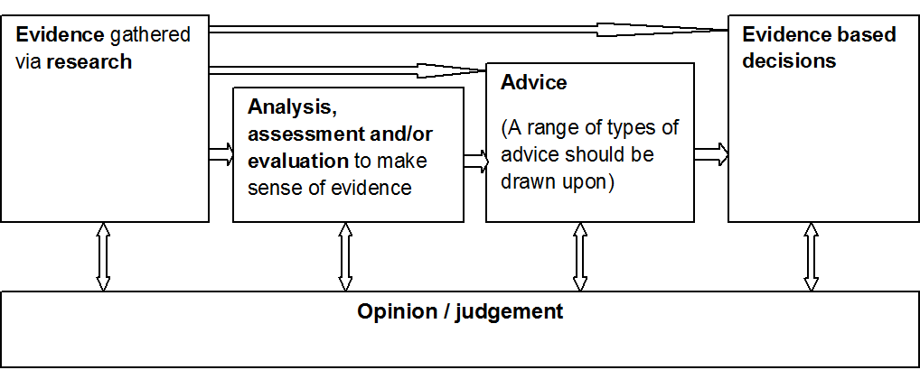
SAGE evidence-based decision making
Notes:
Strategic Advisory
Group of Experts (SAGE

Slide 27
Notes:
We need ‘good enough K’ (Nutley et al, 2013) – depends on the question being asked, what the evidence will be used for
Judgement = what is apt for us? What mix of evidence from different sources do we need? Fit with our values?

Slide 28
Global + Local
Public?
Research
Local?
Evidence
Evaluation
Practice Wisdom

Slide 29
Evidence 1, 2 + 3 (Shulman, 2013)
E3: Deliberative process. Data + Practical judgement + Feelings, Intuitions, Dialectical reasoning
E1: big studies, books
E2: local data
Notes:
Dynamic between the areas is important

Slide 30
Aspect 3:
Planning local evidence for local inquiry

Slide 31
Planning: Evidence Grids
Kreber and Brook (2001) framework
for assessing impact
Chalmers et al (2012)
guide to evaluating lecturer development programmes
McLain (2011)
matrix for evaluating leadership development
Smith (2008)
4Q framework to support evaluation of teaching practice

Slide 32
Triangulate
Usually public, eg published papers, reports
Programme / project module feedback, Focus groups, Self-evaluation, Peer observation
Research
Often tacit, often local:
Practitioner insights, Case examples, Anecdotes, Testimonies, ‘How we do things here’, Self-evaluation
Evidence
Evaluation
Practice Wisdom
Bamber, 2013; Adapted from Bamber, Rowley & Power, 2012
Notes:
Research: ‘privileged as a way of knowing’ (Nutley et al, 2013: 6) because it has documented methodology, peer review, external scrutiny.
BUT we mustn’t lose the valuable situated, local knowledge.
Dynamic of different types of evidence

Slide 33
Planning: Evidence Grid
 | Research |  | Evaluation |  | Practice Wisdom
 | Reports, Policy papers | Journal papers | Consultations | Data from students | Practitioner insights | Dept / subject norms
PGT Experi-ence
Evidence
Activity
Notes:
Research: ‘privileged as a way of knowing’ (Nutley et al, 2013: 6) because it has documented methodology, peer review, external scrutiny.

Slide 34
Planning: Evidence Grid
 | Research |  | Evaluation |  | Practice Wisdom
 | Reports, Policy papers | Journal papers | Consultations | Data from students | Practitioner insights | Dept / subject norms
PGT Experi-ence | QAA, HEFCE, HEA | Tobbell and colleagues, 2009, 2010 and 2013; Coates and Dickinson, 2012; Heussi, 2012; Kember, Ho, and Leung, 2014 | Staff: focus groups. Alumni, employers: email questions | Module questionnaires, Focus groups, PTES, assessment outcomes, blog entries | Case examples, anecdotes | Policy, discipline norms, workload issues, WTP
Evidence
Activity
Notes:
–

Slide 35
Aspect 4:
Turning local evidence into scholarship

Slide 36
Mapping onto Nelson’s Groups (DATE)
What is?
What works?
What could be?
Theory building?
(Hutchings, 2000)
ANYTHING TO SAY RE MY ANALYSIS?
Reports on particular classes
Reflections on years of teaching experience
Larger contexts, comparisons
Formal research
Summaries and analyses of prior studies
Notes:
http://pixabay.com/en/information-information-board-427515/

Slide 37
5. How do you evaluate your learning and teaching activity? In other words, how do you decide whether or not it is going well and students are learning what you want them to learn?
Peer Observation: 16
University /dept questionnaire: 15
Own questionnaire: 25
Mentoring: 3
Reflection on practice: 41
Peer Review of materials: 14
Tests: 8
Assessment Results: 39
In-class feedback: 28
L&T Research: 8
Ad hoc discussion with students: 42
Other Peer Feedback: 9
Other Student Feedback: 12

Slide 38
Principles
‘guideposts for developing and refining both individual SoTL inquiries and larger SoTL initiatives’ (Felten, 2013: 124):
Inquiry focused on student learning
Grounded in context (local and scholarly)
Methodologically sound
Conducted in partnership with students
Appropriately public.

Slide 39
Evidence-informed scholarliness becomes scholarship
Scholarliness for:
Investigation of practices
Aimed at improving practices
Informed by appropriate literature
Using the experience of practitioners involved
Scholarship:
All of those, and
‘Going meta’ (Hutchings and Shulman, 1999)
Subjecting to critique of others
Informing wider audience
Becoming public knowledge
Notes:
Going meta – Hutchings and Shulman, 1999

Slide 40
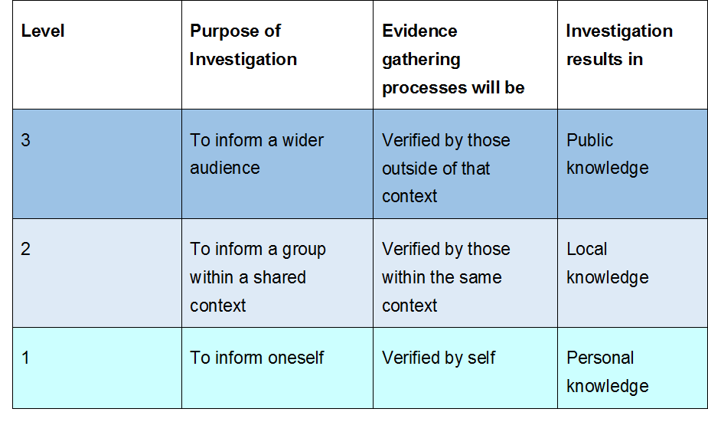
Levels of Pedagogic Investigation (Ashwin & Trigwell, 2004)
Notes:
3 qualitatively different aims of investigation of practice – to develop local K, personal, public. ‘We argue that these different types of K are associated with different standards of evidence and of ways of collecting that evidence, and they will have a different range of implications.’ (Ashwin and Trigwell, 2004: 118). ‘research is not a necessary condition for the scholarship of staff and educational development’ (Ashwin and Trigwell, 2004: 118). [BUT it strengthens the triangulation of our k}
Hutchings and Shulman (99) ‘going meta’ – advancing practice beyond our classrooms, not just in them

Slide 41
Aspect 5:
Making a difference to our local knowledge and practices

Slide 42
Evidence-informed practices
Publishable
Virtuous mess

Slide 43
Your Evidence
You are planning a new PTAS project -
What will your evidence grid look like?

Slide 44
References
Ashwin, P. and Trigwell, K. (2004) Investigating educational development. In: Enhancing staff and educational development. Kogan Page, London, pp. 117-131.
Bamber, V (Ed) (2013) Evidencing the Value of Educational Development. SEDA Special No 34. ISBN 978-1-902435-56-5
Bamber, J., Rowley, C. and Power, A. (2012) ‘Speaking evidence to youth work – and vice versa’, Journal of Youth Work – research and positive practices in work with young people, 10, pp. 37-56.
Biesta, G. (2007) ‘Why ‘‘What Works’’ Won’t Work: Evidence-Based Practice and the Democratic Deficit in Educational Research’. Educational Theory, 57(1), 1-22.
Felten, P. (2013) Pricniples of Good Practice in SoTL. Teaching and Learning Inquiry, Vol 1, Issue 1, pp 121-125.
Hutchings, P. and Shulman, L. S. (1999) The Scholarship of Teaching: New Elaborations, New Developments. Change, 31, 5. Pp 10-15. http://www.carnegiefoundation.org/publications/sub.asp?key=452&subkey=613
Kelly, T. (2008) Evidence. In The Stanford Encyclopedia of Philosophy, E. N. Zalta (Ed) http://plato.stanford.edu/archives/fall2008/entries/evidence/. (Last accessed 12-1-2013).
McArthur, J. (2012). Virtuous mess and wicked clarity: struggle in higher education research. Higher Education Research and Development. 31:3, 419-430.
Nutley, S, Powell, A and Davies, H (2013) What counts as good evidence? Provocation Paper for the Alliance for Useful Evidence. St Andrews: Research Unit for Research Utilisation
Hutchings, P. (ed) 2000: Opening lines: Approaches to the scholarship of teaching and learning. The Carnegie Foundation for the Advancement of Teaching, Menlo Park.

Slide 45
Thank You

