Slide 1

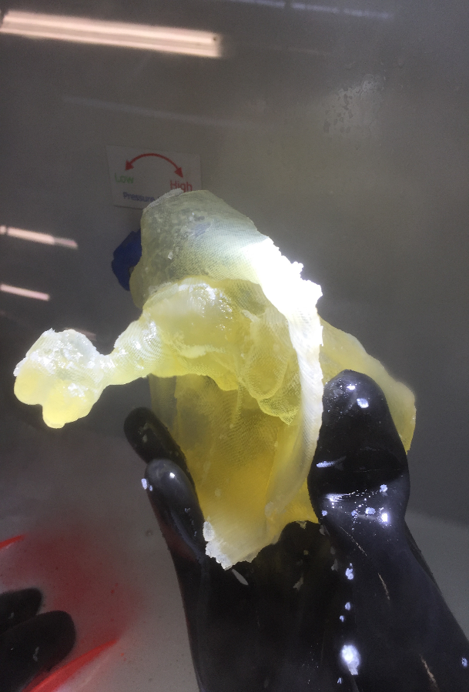
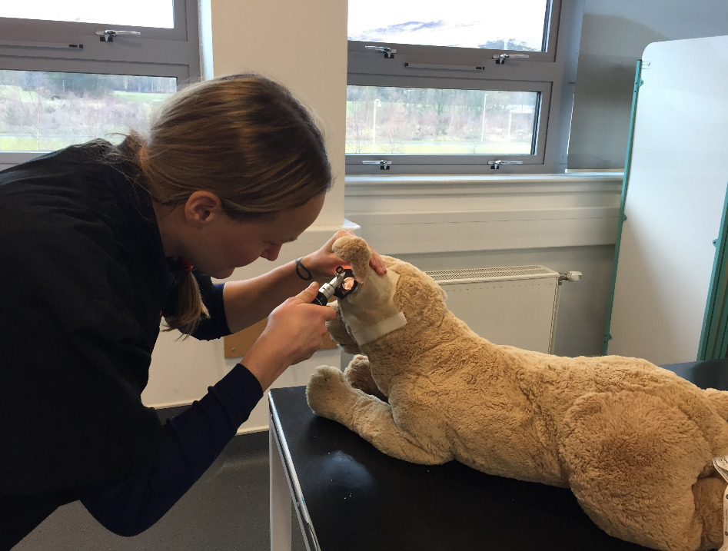
Creation and Evaluation of a 3-D Printed Model to Support Otoscopy Skills in Veterinary Students
Stendahl, A., Schwarz, T, Collins, R., Mosley, C. Rhind, S. R(D)SVS, University of Edinburgh
Background
There is an increase in the demand for new teaching modalities to teach anatomy and clinical skills to students in veterinary medicine due to the increasing reluctance to use live animals and the difficulty in obtaining ethically sourced cadavers.
Model Creation
A 3D model of a canine ear canal was created by acquiring CT images of a healthy canine ear canal to recreate a rendered 3D image suitable for 3D printing. Initially the model was printed in hard material with the final model printed in a flexible material on an Object Connex printer to mimic the pliability of the ear canal as closely as possible. The finished ear model was inserted into a stuffed model patient.
Evaluation
Thirty students were recruited to evaluate the model.
Pre and post surveys were created to ascertain how much training the student had previously had, how confident they felt with the procedure before and after and qualitative comment son their experience with the model.
Figure 2. Shows how confidence before and after relates to any previous training they have had. The ‘y’ axis shows the 5 point likert scale of strongly disagree (-2), disagree (-1), neither agree nor disagree (0), agree (+1), strongly agree (+2). The ‘x’ axis is showing their confidence berfore and after and whether they have had previous training or not.
The results also show that of the 30 students, 23 ‘strongly agreed’ and seven ‘agreed’ that the model should be introduced into the curriculum. Some of the feedback from the students in this study suggested printing models that depict ear disease, printing models from different breeds of dogs, such as brachiocephalic breeds that may prove more difficult to examine, and introducing numbers or letters at the level of the tympanic membrane to examine.
Fig. 1
3 D print
and
completed model
Conclusions
Innovations in teaching modalities are opening new avenues and uses for 3D printing. This project has proven that by using 3D printing in education, we can teach students important clinical skills such as otoscopy, and allow them repeated attempts until they feel confident in the technique required without any concern for the welfare of the live animals that would otherwise have been used.

